Slide 1

Welcome to
Norwood Primary School

Slide 2
April | 16th April offer date
May | 8th May Parent and Carer welcome meeting. Book bags, Tapestry, key information.
June | Tapestry support videos Mrs Blake/Tomeo visiting preschools First New to Norwood visit/Fayre -30th June
July | New to Norwood play sessions Friday 4th and Monday 7th July Friday 11th July 1:1 parent meetings
August | Summer Holidays
September | Wed 3rd Sep - Group 1 morning visit 9:15 to 11:30 Group 2 1:15 – 3:15 Thursday 4th Sep- Group 1 morning and lunch visit 9:15 to 12:30 Group 2 1:15 – 3:15 Friday 5th Sep – Group 1 morning and lunch visit 9:15 to 12:45 Group 2 1:15 – 3:15

Slide 3
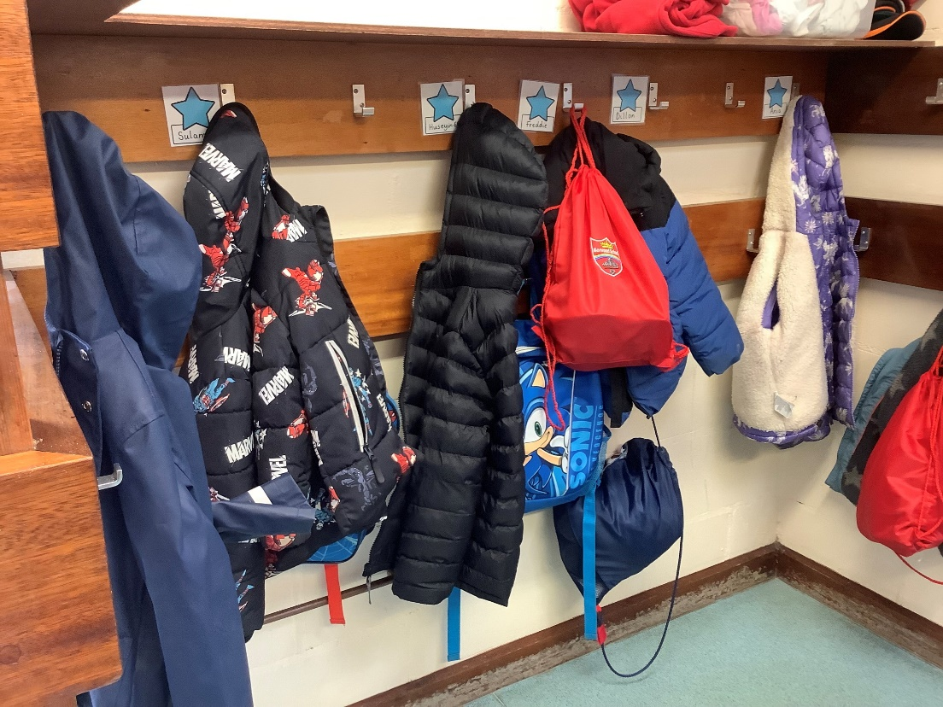
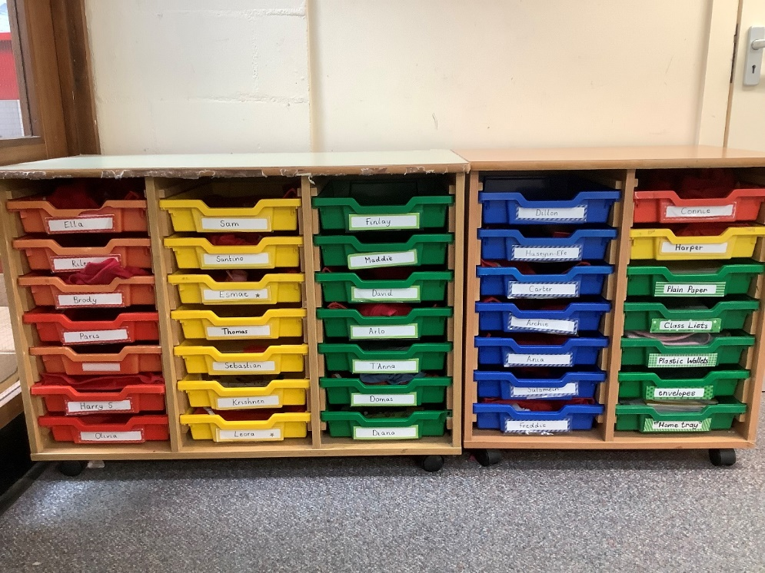
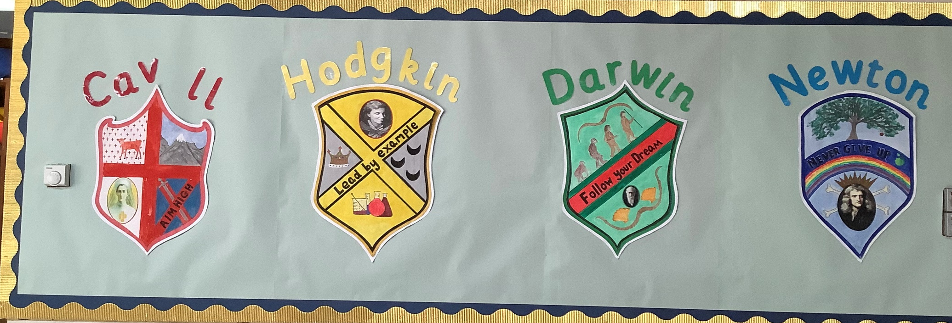

Slide 4
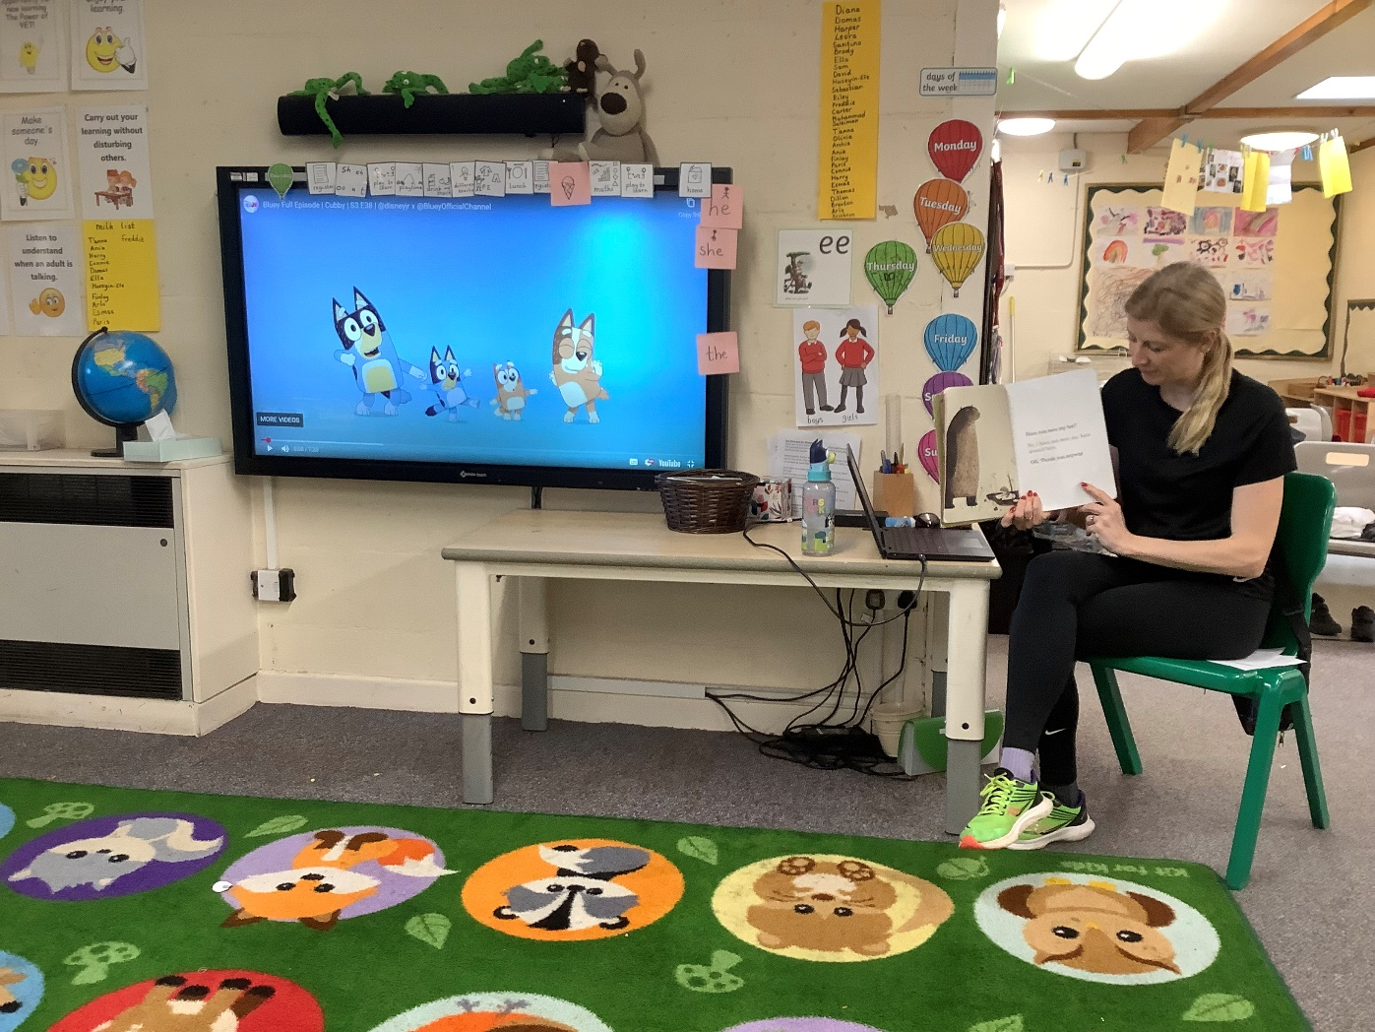
Routine
Days of the week song
Carpet spaces
Talking through the daily visual timetable

Slide 5
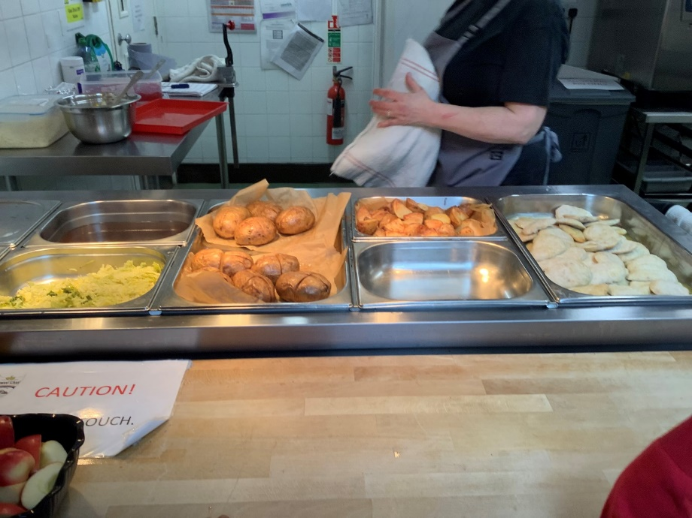
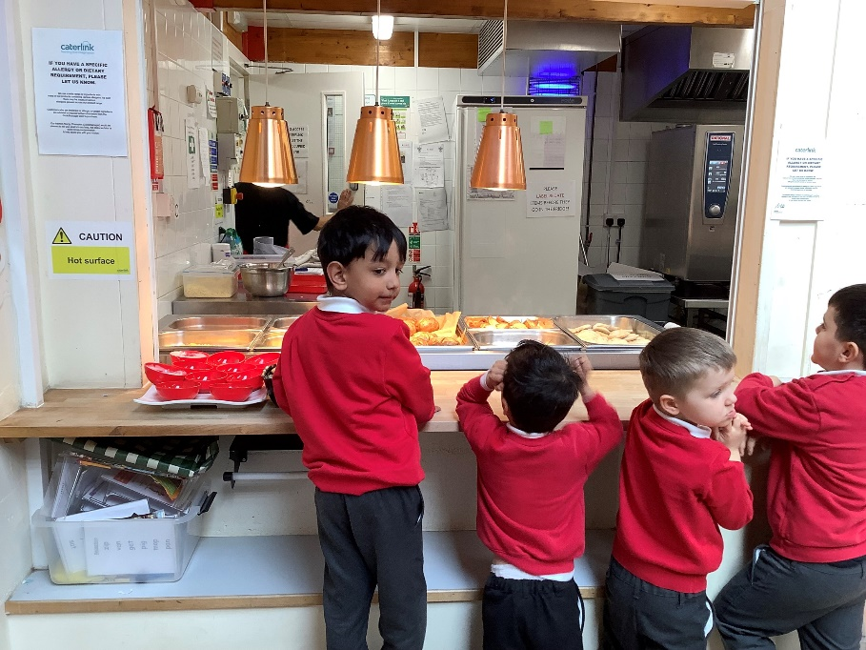
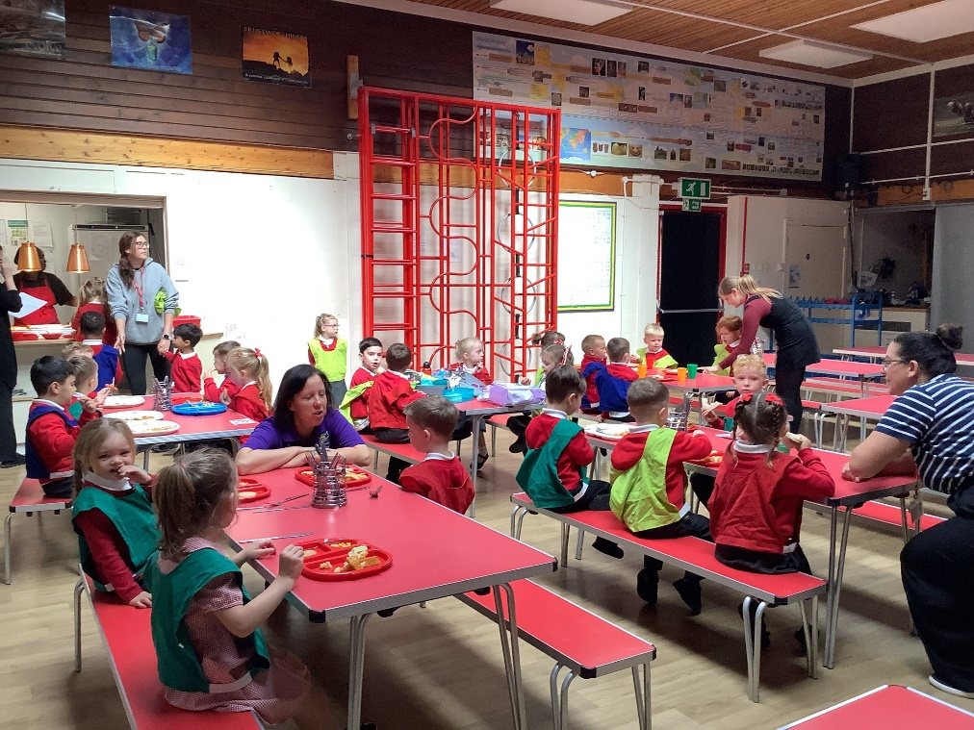
Lunchtimes

Slide 6
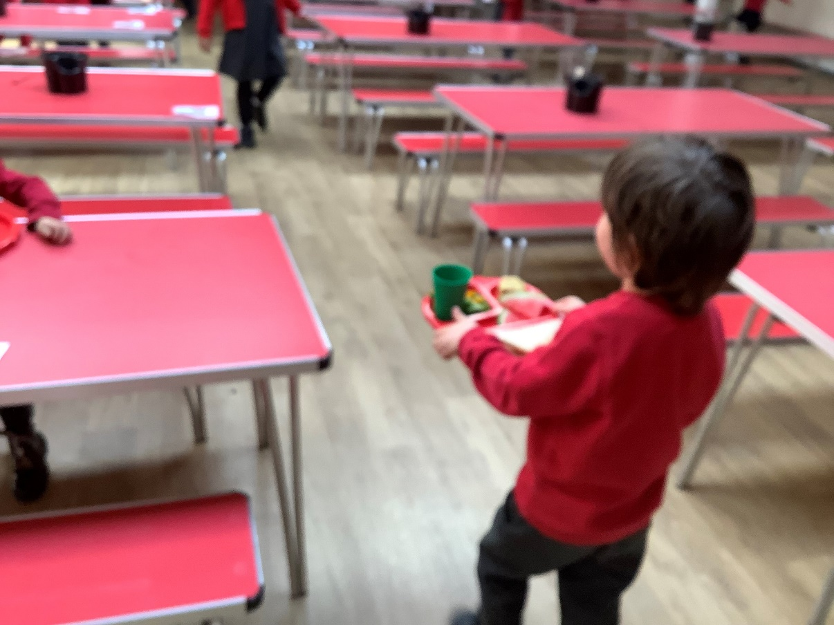
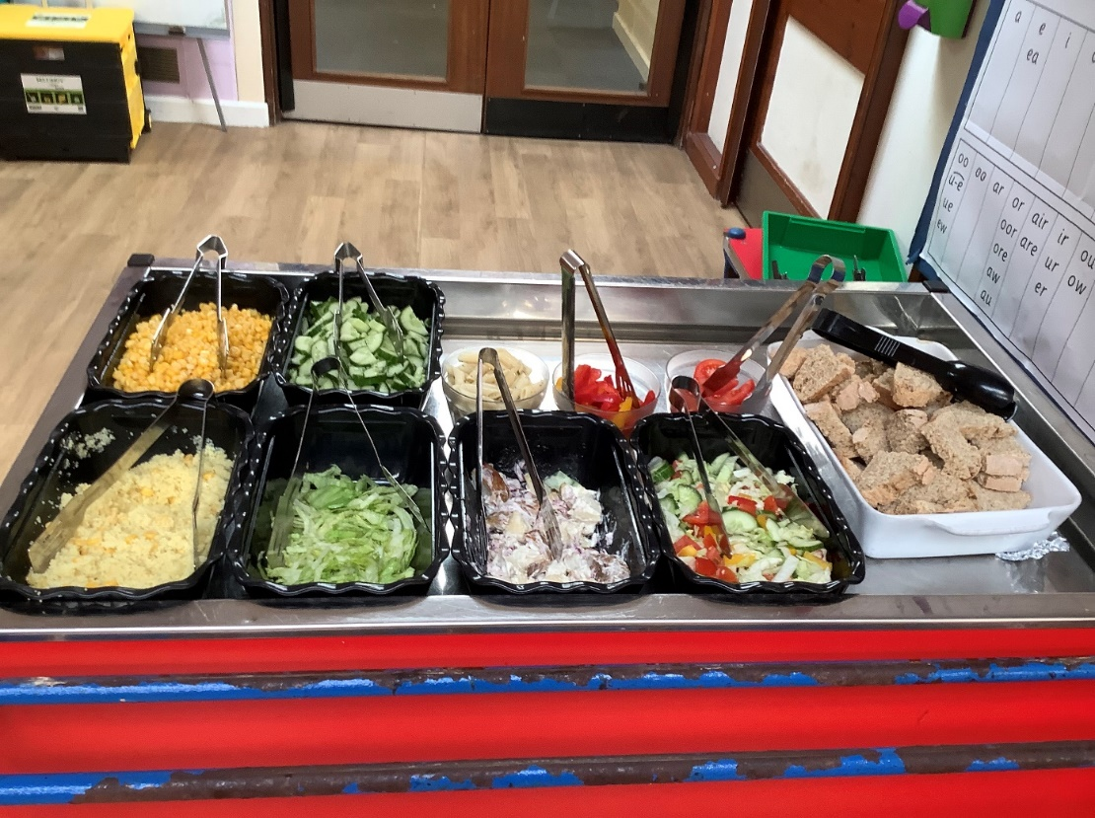
Independence, choice, cutlery

Slide 7
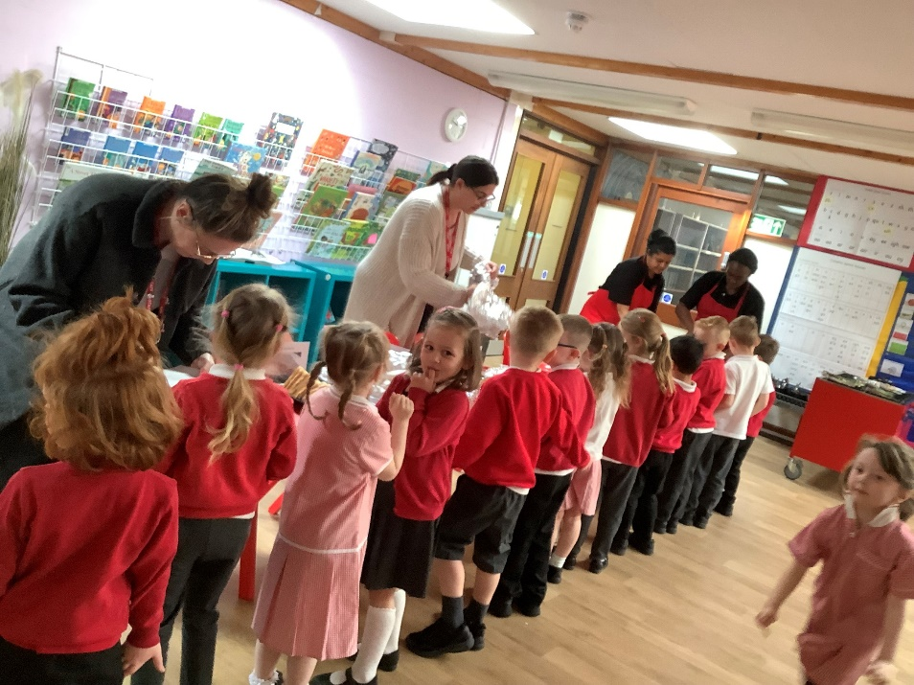
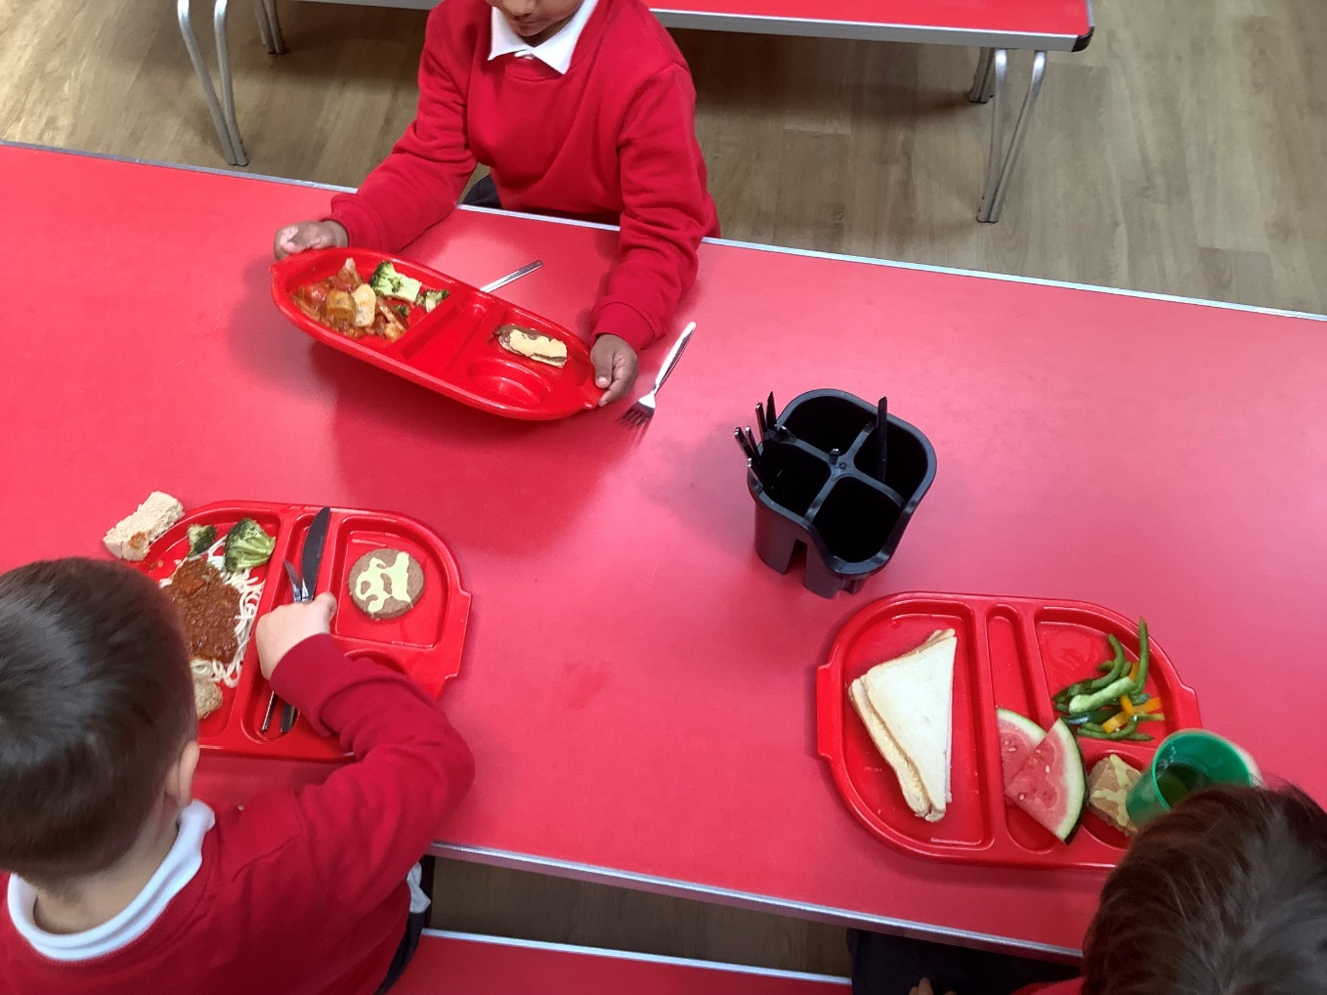
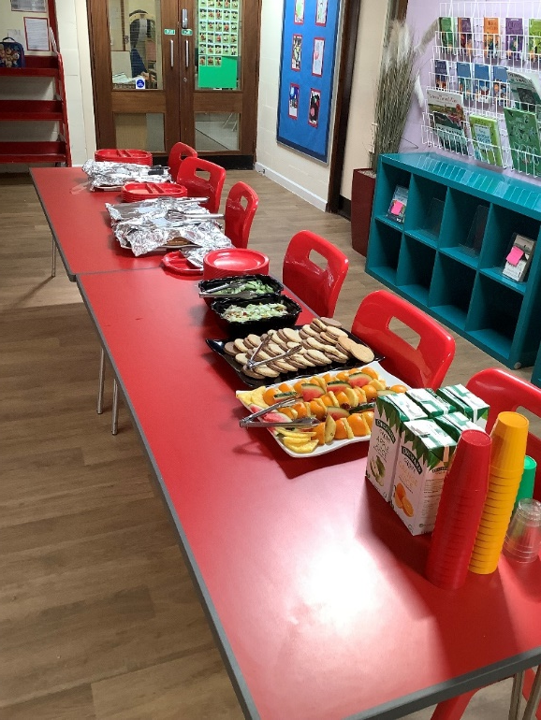
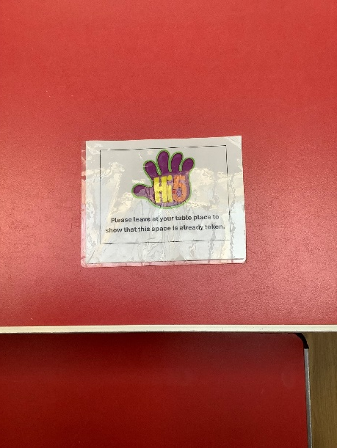
High fives

Slide 8
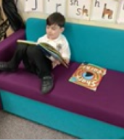
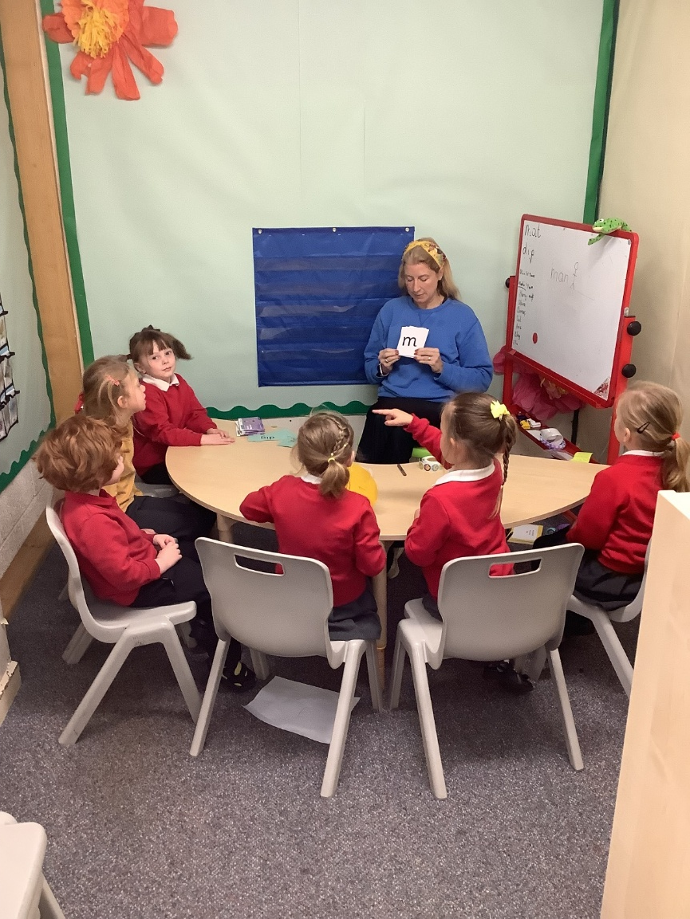
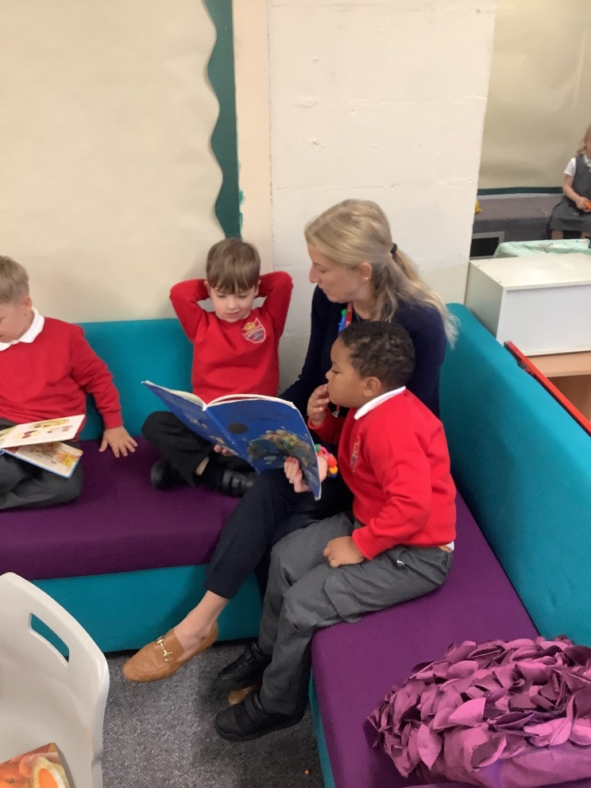
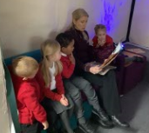
Reading

Slide 9


Read Write Inc

Slide 10
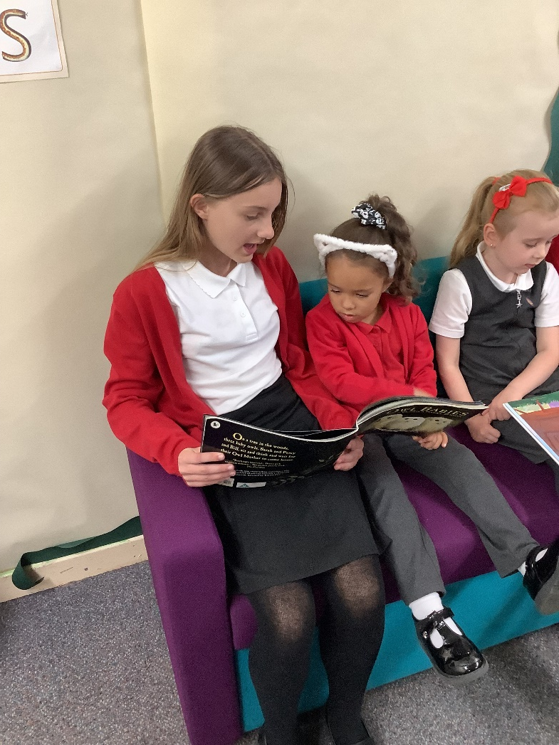
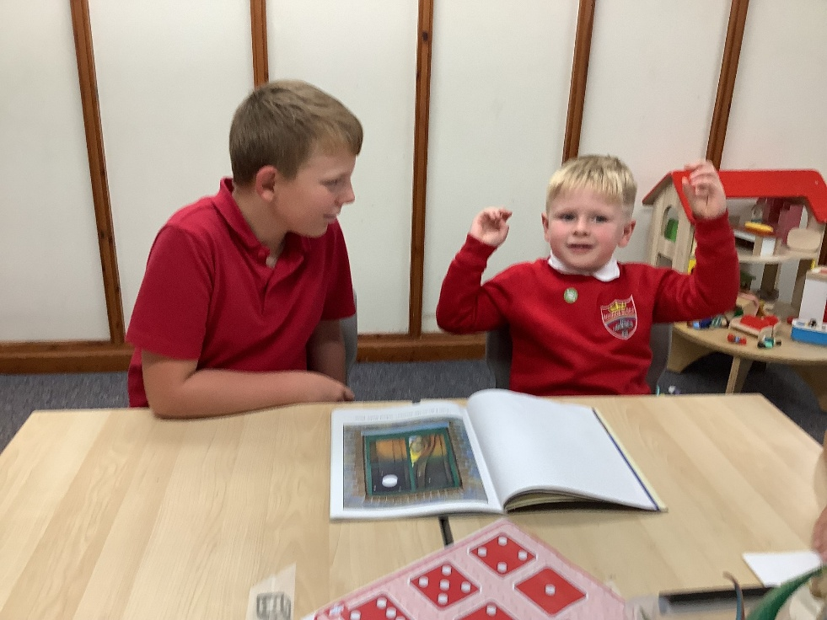
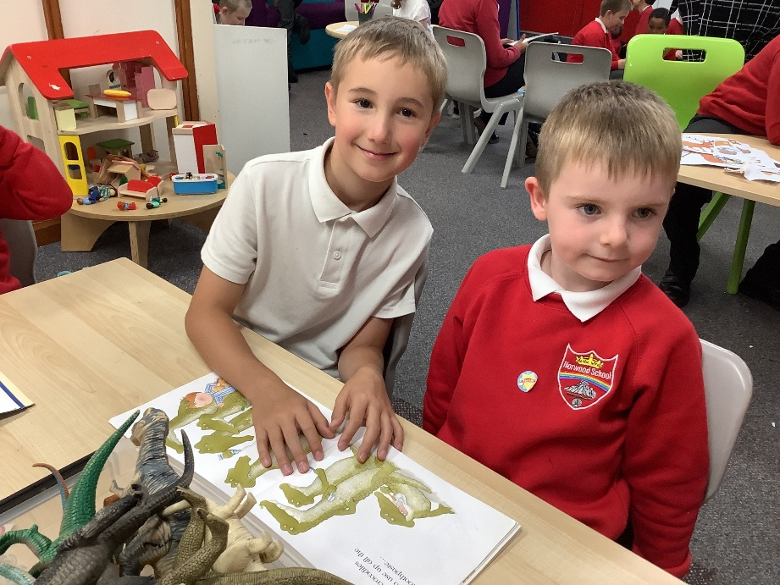
Buddies

Slide 11
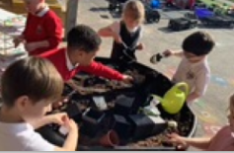
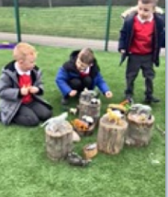
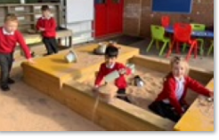
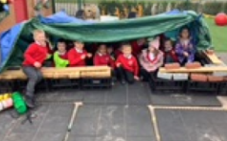
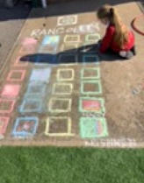
Outdoor Play

Slide 12
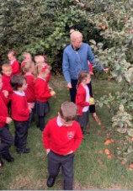
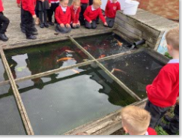
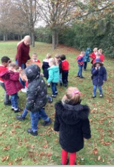
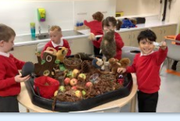

Slide 13
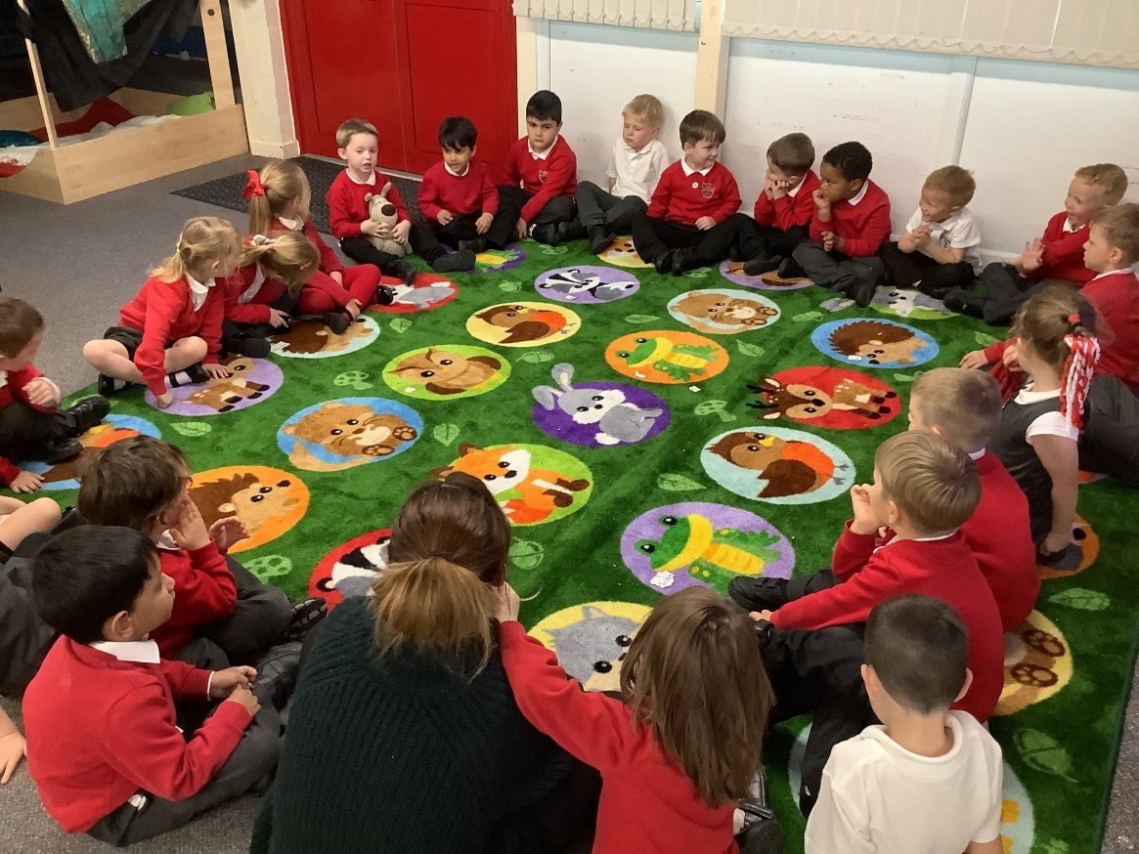
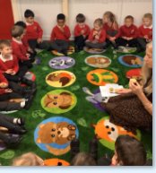
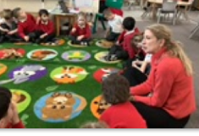
Circle times

Slide 14
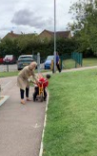
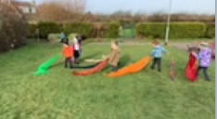
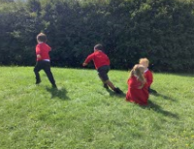
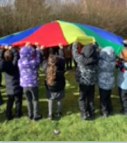
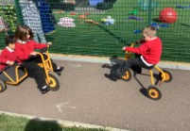
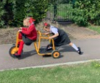
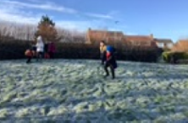
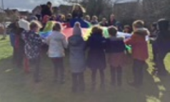
Playtimes

Slide 15
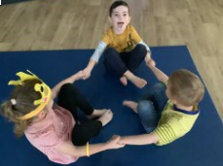
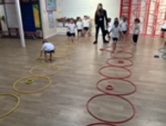
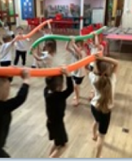
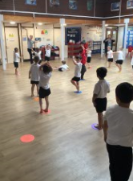
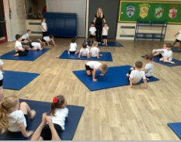
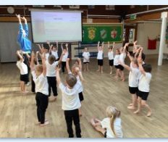
PE

Slide 16
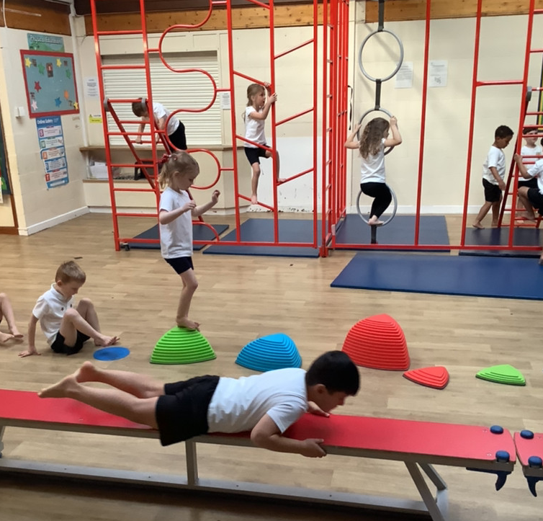
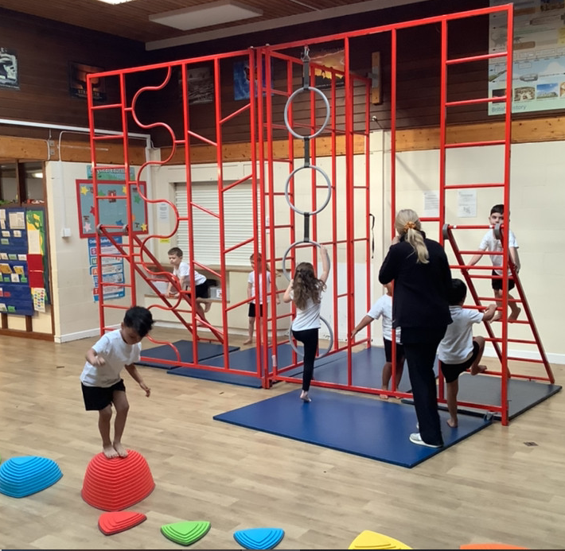
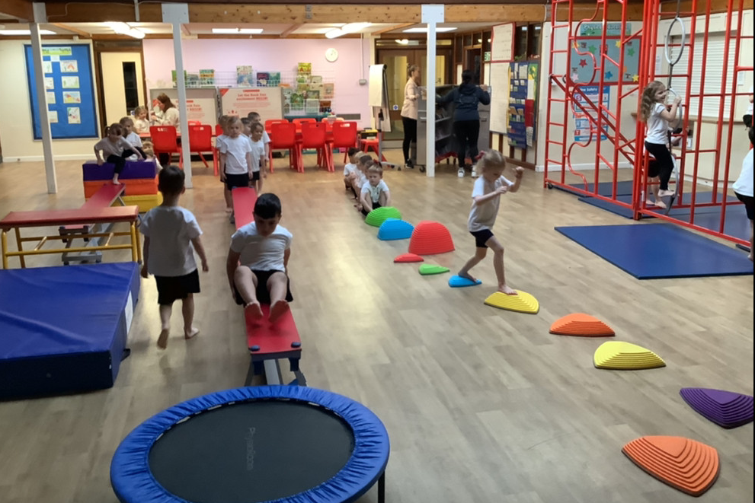
Apparatus

Slide 17
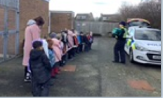


Special days

Slide 18




Picnics

Slide 19


Nativity play

Slide 20


TAPESTRY You will receive a link – you will be able to see what your child is doing each week.

Slide 21

Milk- you must register for your child’s free milk.

Slide 22
SEN
Our Deputy Head Teacher is also our Special Educational Needs Lead.
Please talk to Mrs Tomeo with any questions or concerns that you may have about your child.

Slide 23

EAL
Speak in own language at home
Multi lingual is an asset
Children immersed in social interaction
and language
Celebrate differences and their language

Slide 24


Slide 25


Slide 26


Slide 27


