Slide 1

Welcome to
Norwood Primary School

Slide 2
May | Monday 18th May Parent and Carer welcome meeting 4-5pm Book bags, Tapestry, key information.
June | Support videos uploaded to school website Mrs Blake/Tomeo visiting preschools Tuesday 23rd June and Thursday 25th June 2025, from 9:15 – 3.00pm 1:1 meetings Group 1 Surnames from A to N Group 1 – Monday 29th June 2026 9.30am – 11.00am Play session in Reception class, 1 familiar adult may attend.
July | Group 2 Surnames from O to Z Group 2 – Friday 3rd July 2026 9.30am – 11.00am Play session in Reception class, 1 familiar adult may attend. Group 1 and Group 2 All Children Monday 6th July 2026 9.30am – 11.00am During this session, we request that you drop your child off and leave them with the adults that they will be working with in September.
August | Summer Holidays

Slide 3
September 2026 Transition timetable
Monday 7.9.26 | Tuesday 8.9.26 | Wednesday 9.9.26 | Thursday 10.9.26 | Friday 11.9.26
Group 1 9:15-11:30 Group 2 1:15-3:15 | Group 1 9:15-11:30 Group 2 1:15-3:15 | Group 1 9:15-11:30 Group 2 1:15-3:15 | Group 1 9:15-11:30 Group 2 1:15-3:15 | Group 1 9:15-11:30 Group 2 1:15-3:15
Monday 14.9.26 | Tuesday 15.9.26 | Wednesday 16.9.26 | Thursday 17.9.26 | Friday 18.9.26
Group 2 9:15-12:30 Group 1 1:15-3:15 | Group 1 9:15-12:30 Group 2 1:15-3:15 | Group 1 and 2 8:45-2:00 | Group 1 and 2 8:45- 3:15 | Group 1 and 2 8:45-3:15
Monday 21.9.26 | Tuesday 22.9.26 | Wednesday 23.9.26 | Thursday 24.9.26 | Friday 25.9.26
Full time 8:45-3:15 for those children that are ready and regulated.

Slide 4
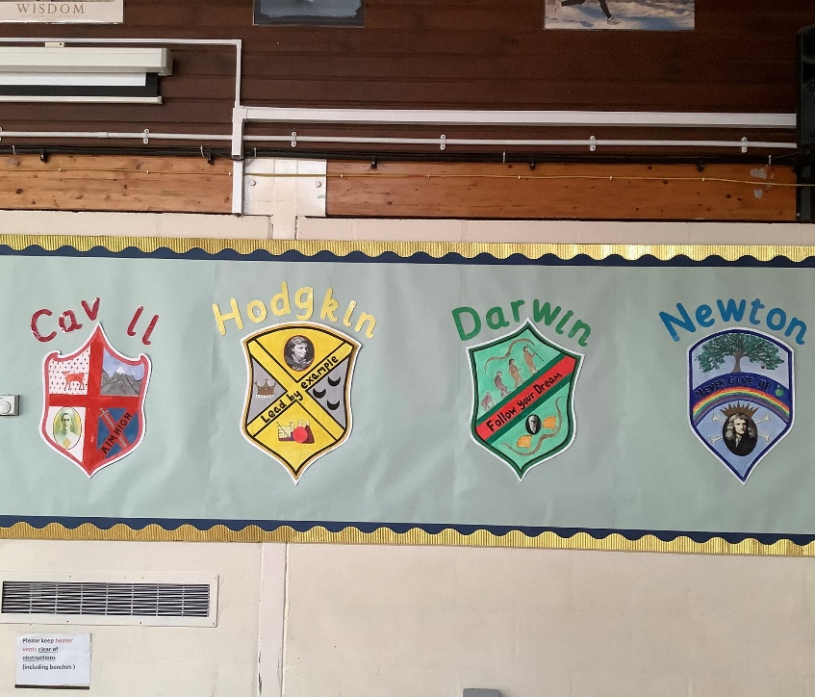
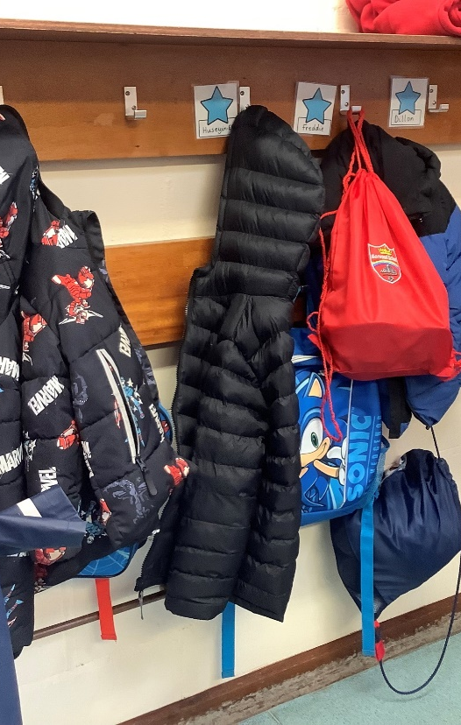
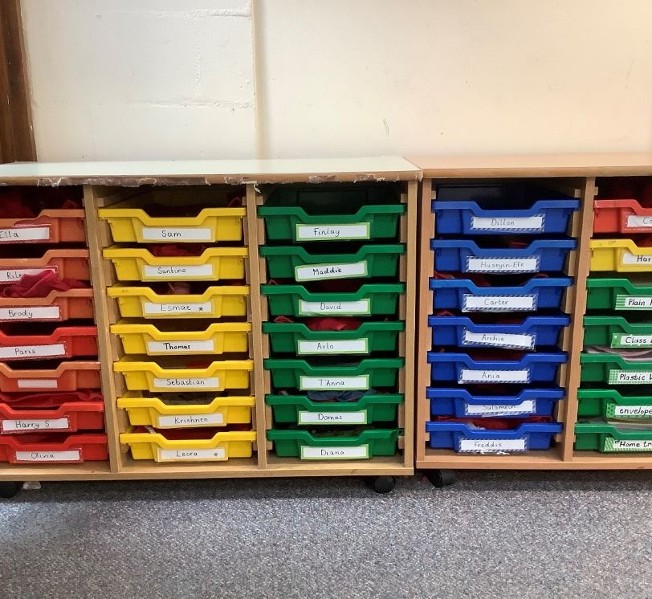
Family Houses
All children in school are in a family.
CAVELL
HODGKIN
DARWIN
NEWTON
From when they start in Reception, they have this colour for their tray, their coat peg label and to know which group they are in.

Slide 5
Cavell | Hodgkin | Darwin | Newton
Kevin Autumn Damaris Jessica Haris | Luis Izabele Willow Jacob Leyla | Nedas Laial Olivia Himani Kyran | Aarya Neil Emir Emris Darcy Atlas

Slide 6
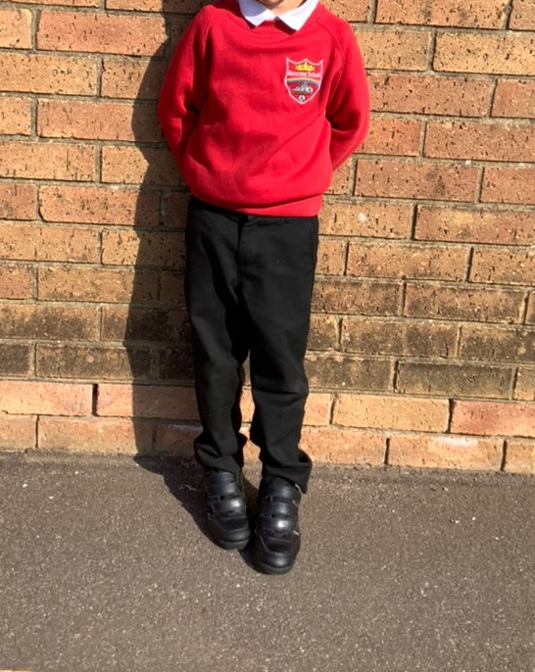
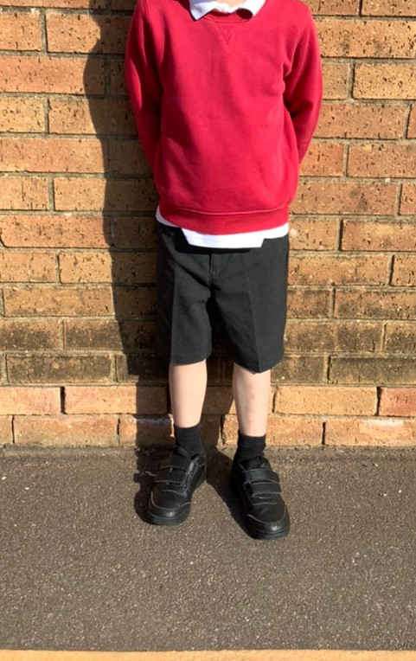
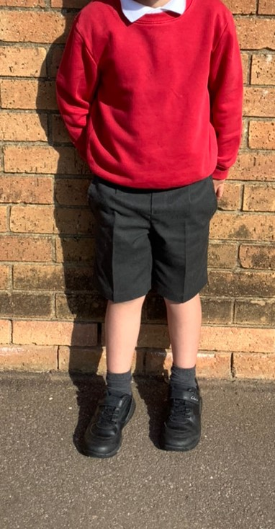
Uniform

Slide 7
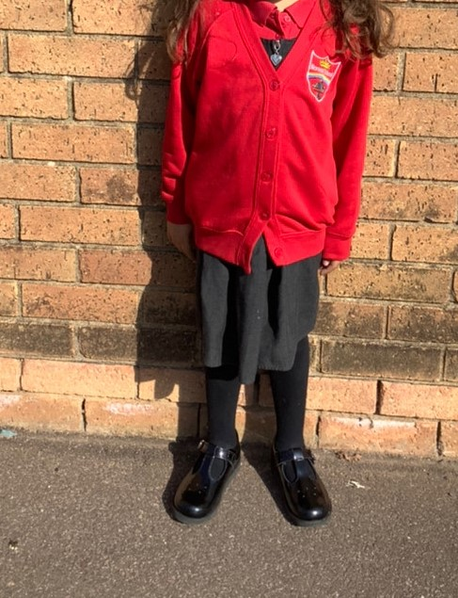
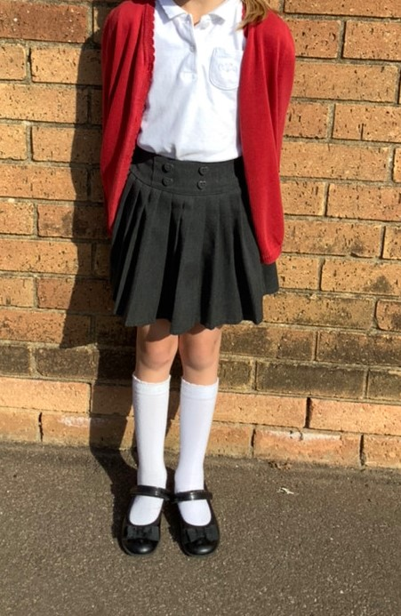
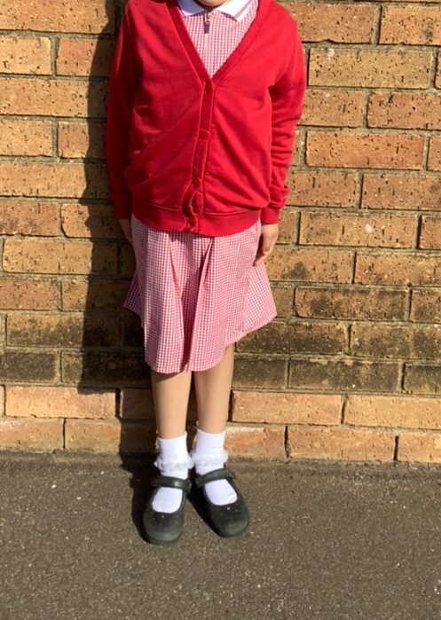
Uniform

Slide 8
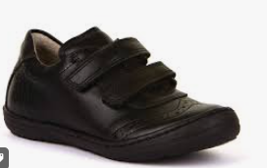
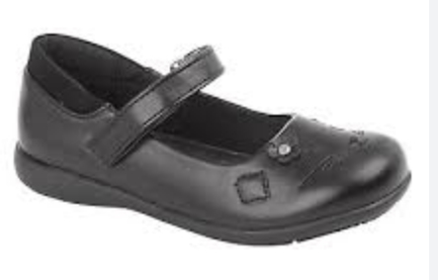
Shoes
All children need to have shoes with velcro.
NO SHOELACES.
This is because the children need to be able to independently take their shoes off and put them on themselves.

Slide 9
PE bag and kit
Black shorts
White t shirt.
Trainers/plimsolls in the summer term.

Slide 10
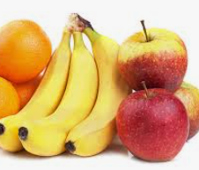

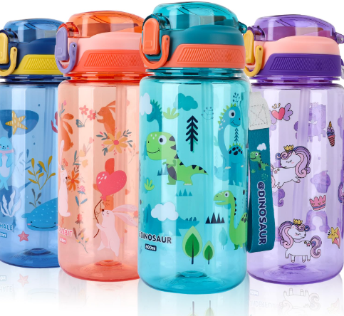
Drink and snack
We have drink and snack time each day.
Children need their own water bottle. (It needs to be named)
WATER ONLY in bottles.
Fresh fruit is provided each day, so children do not need to bring a snack.

Slide 11
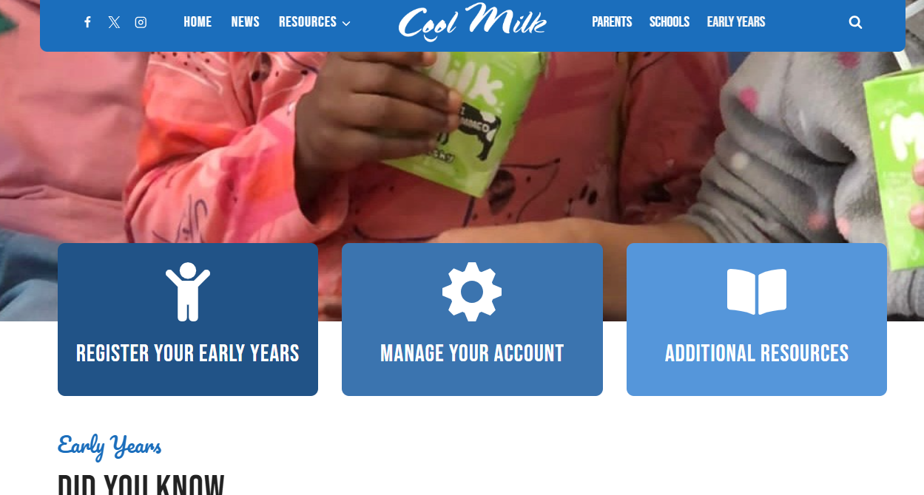
Milk- you must register for your child’s free milk.

Slide 12
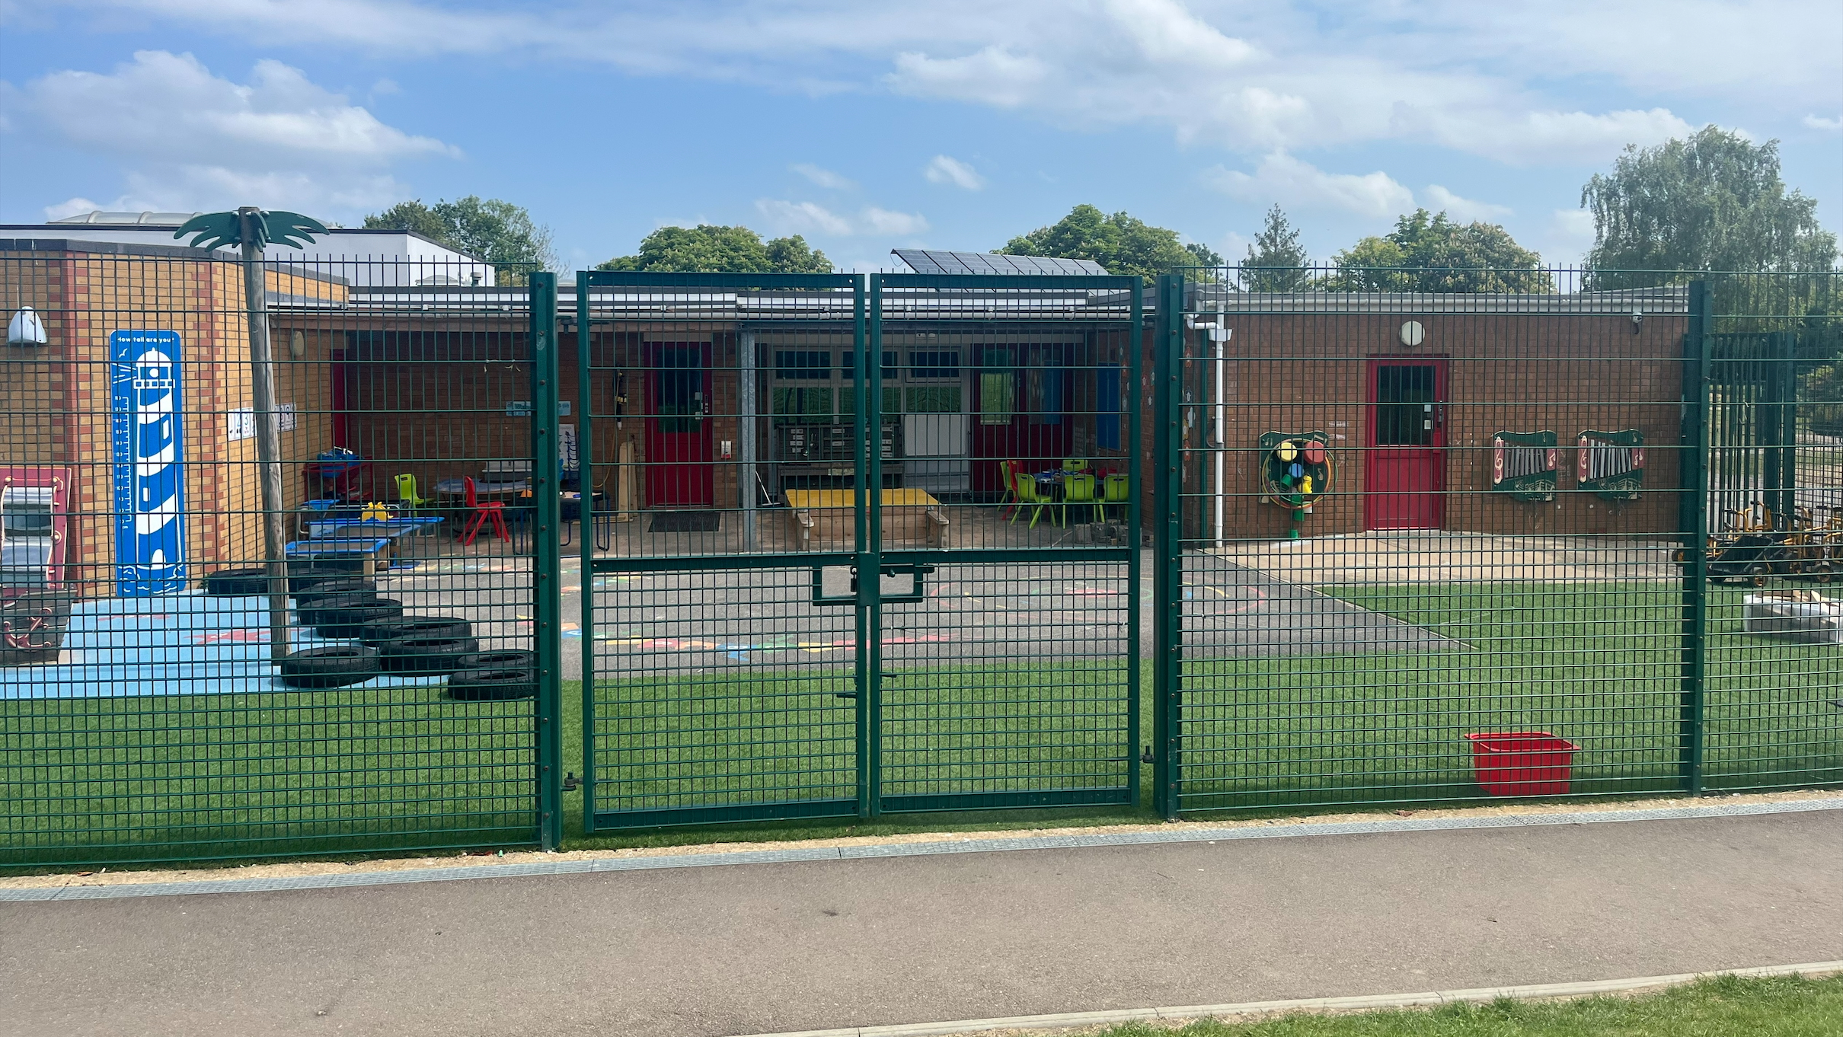
Gates open at 8:45 and close at 8:55

Slide 13
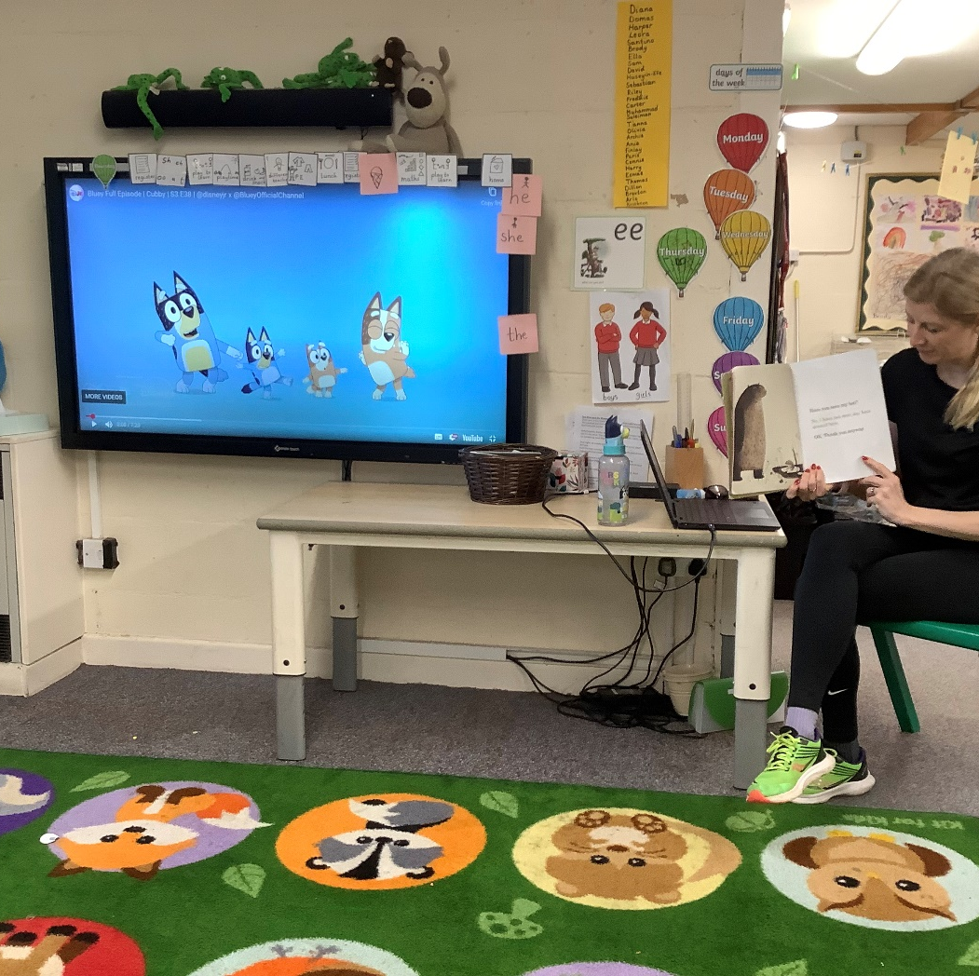
Routine
Days of the week song
Carpet spaces
Talking through the daily visual timetable

Slide 14
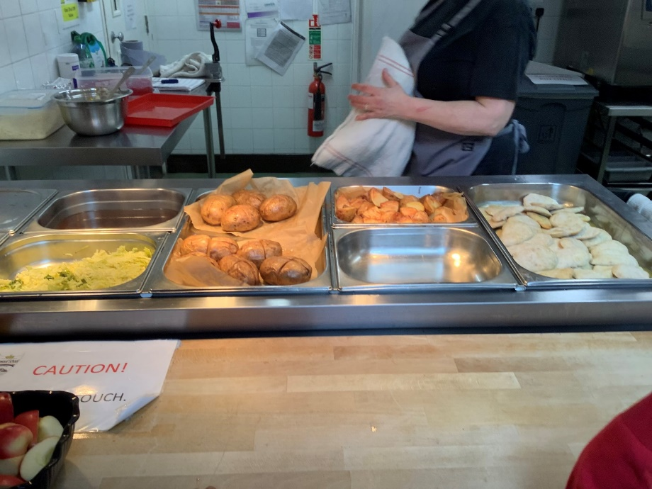
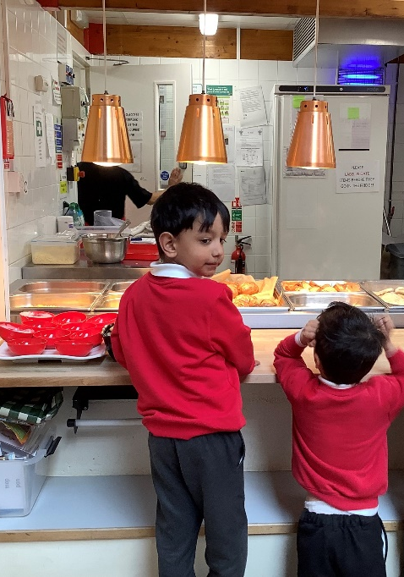
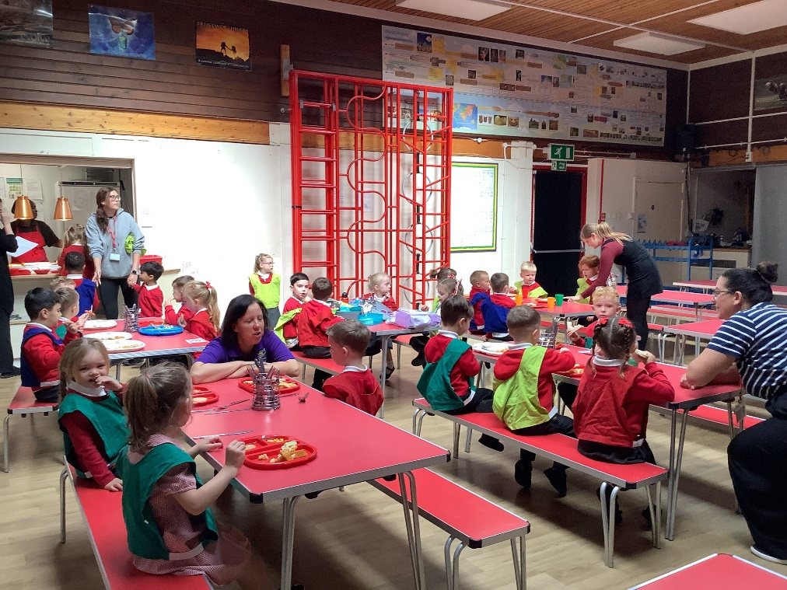
Lunchtimes
Reception have their lunch at 11:45 before the rest of the school. They are very well supported by adults. They sit together regardless of what they are having.
Hot dinner
Jacket Potato
High 5- cheese/ham/tuna
Packed Lunch

Slide 15
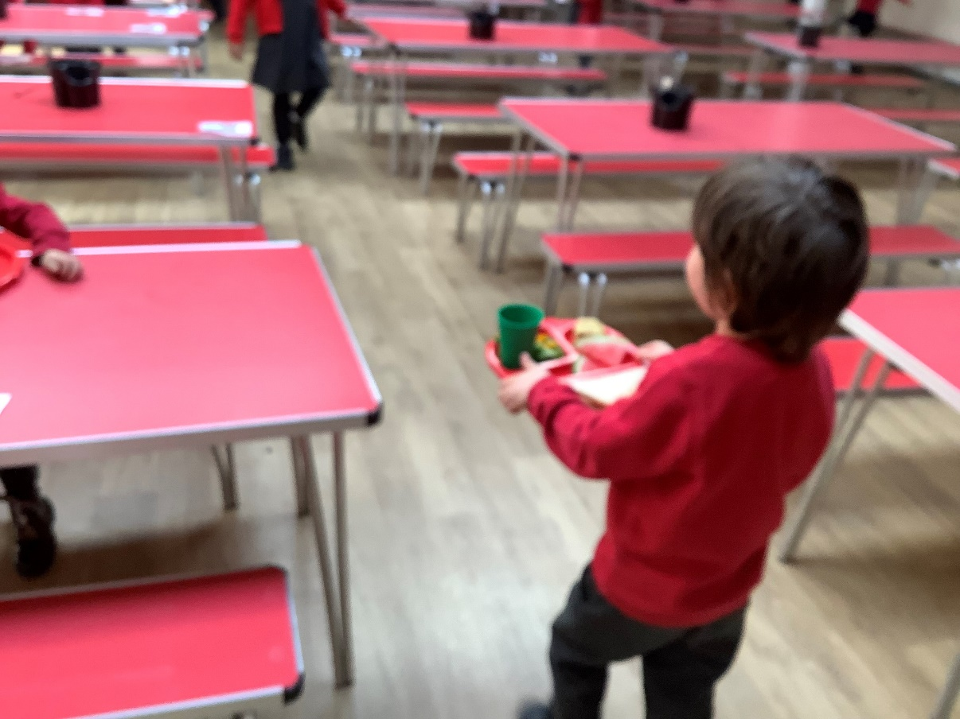
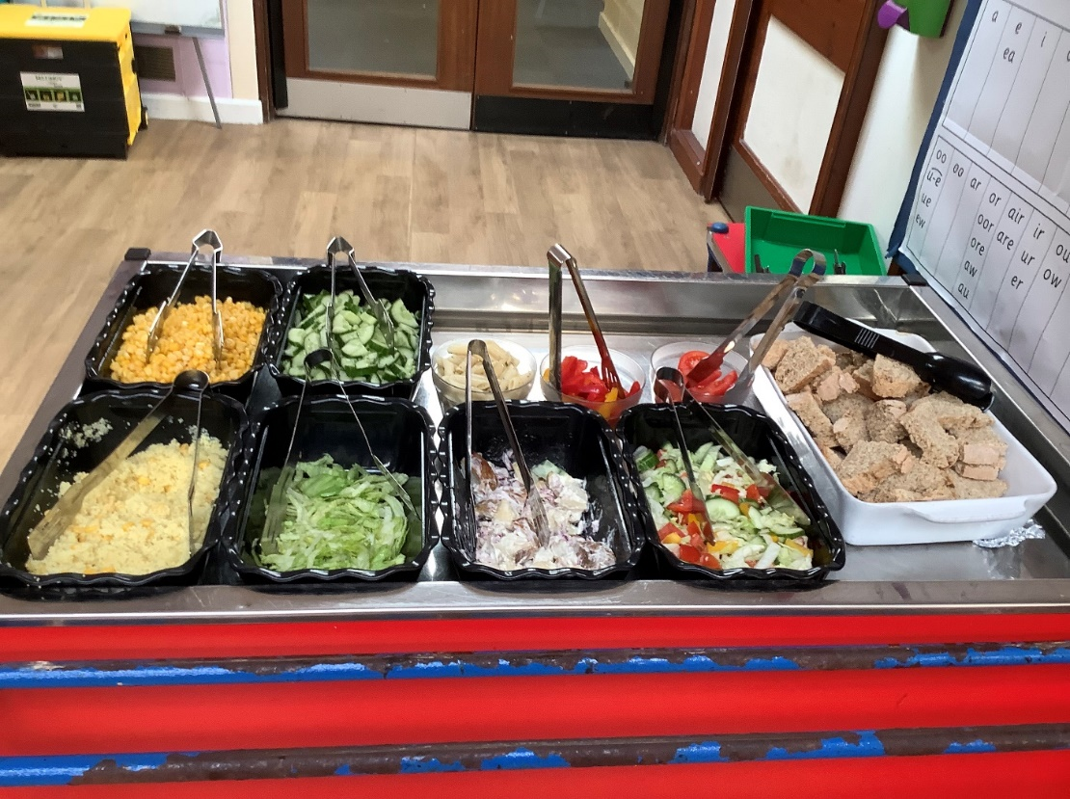
Independence, choice, cutlery

Slide 16
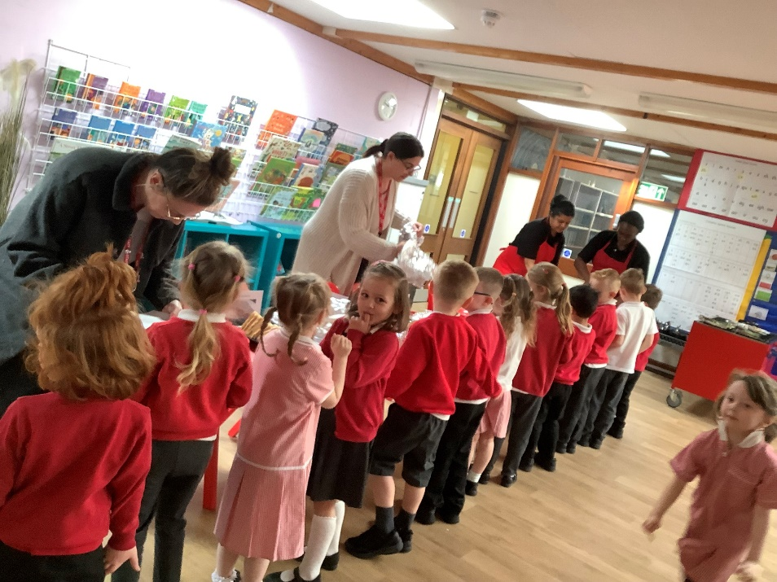
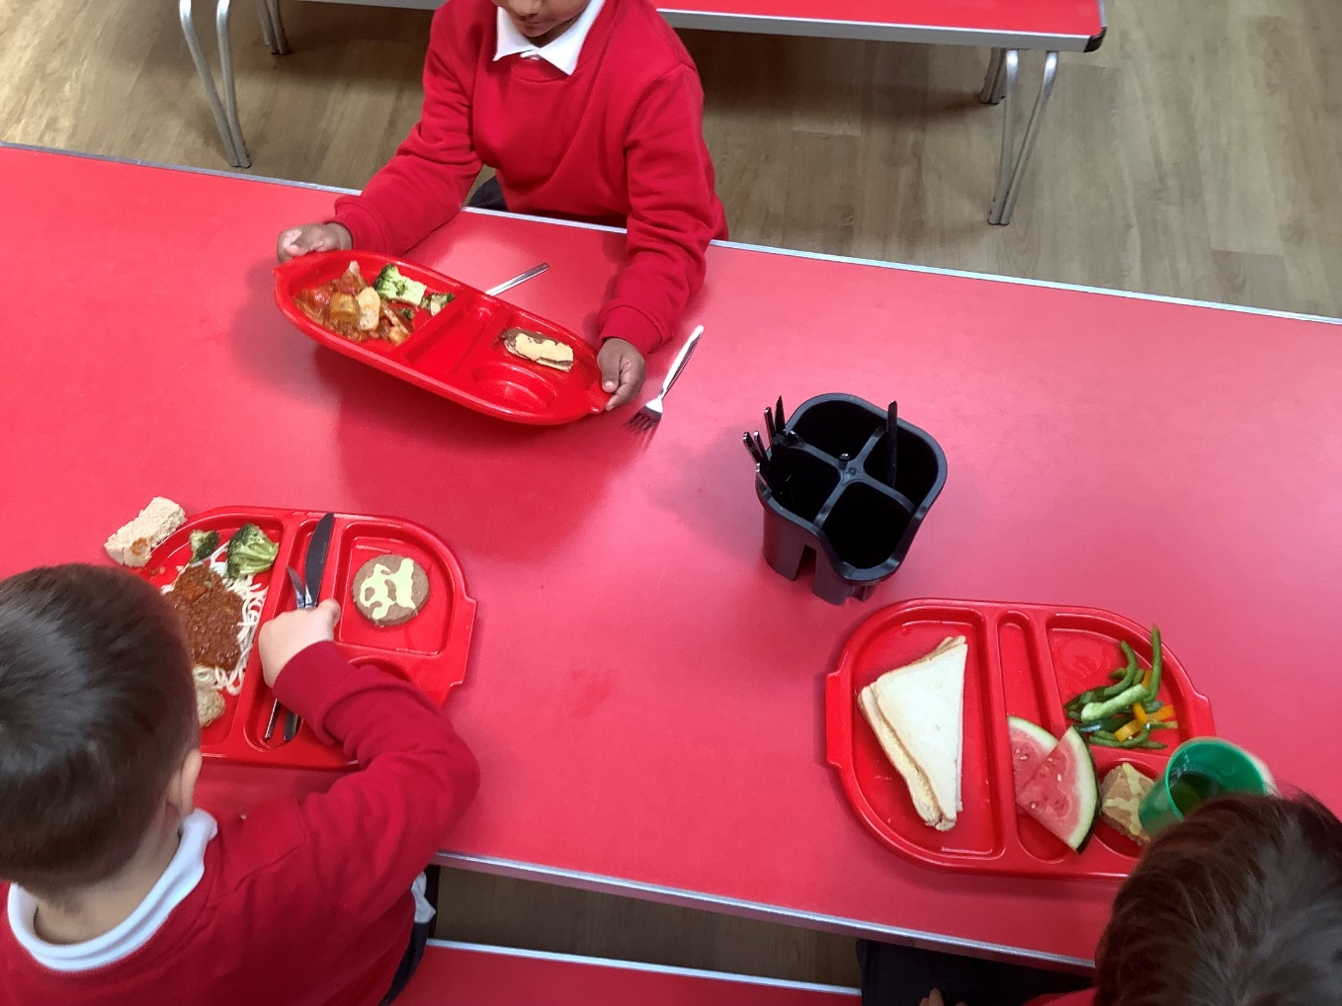
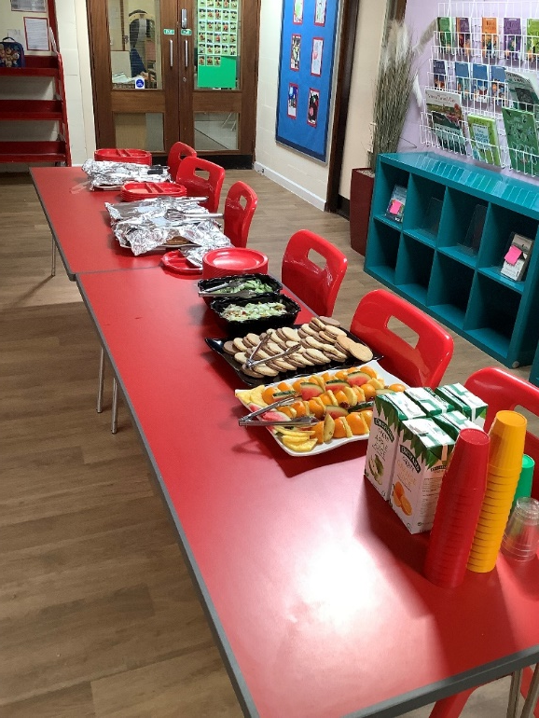
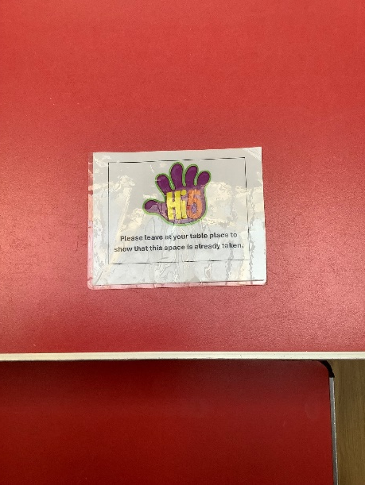
High fives

Slide 17
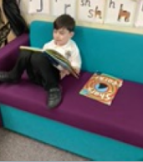
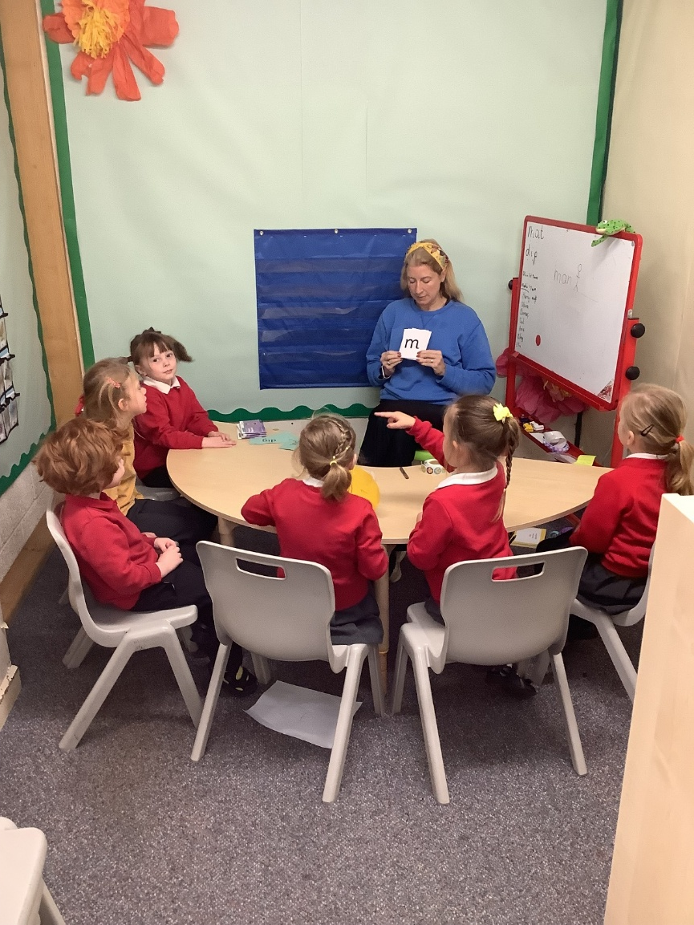
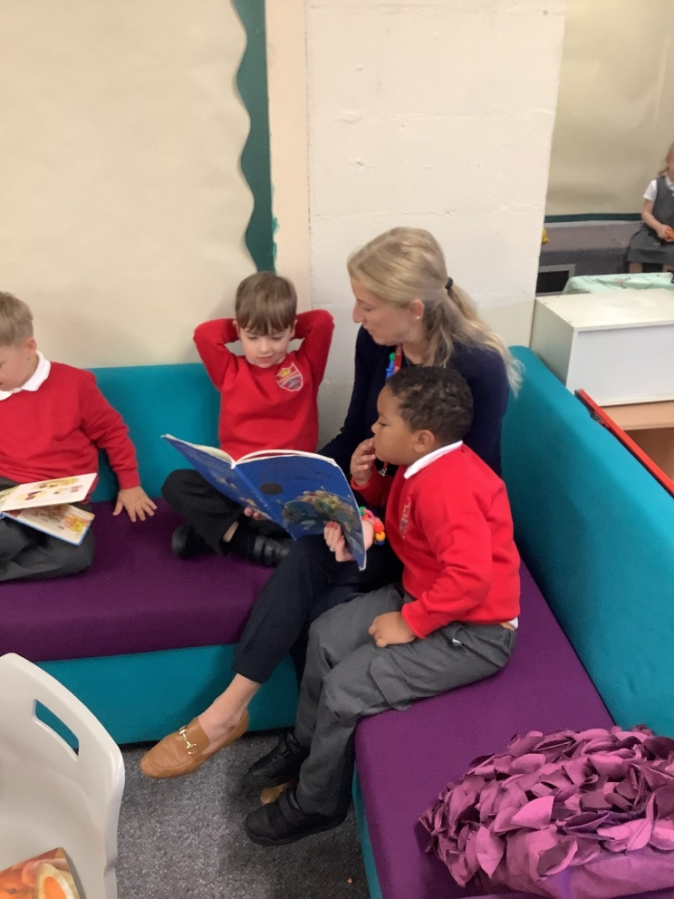
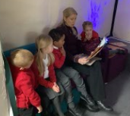
Reading

Slide 18


Read Write Inc

Slide 19
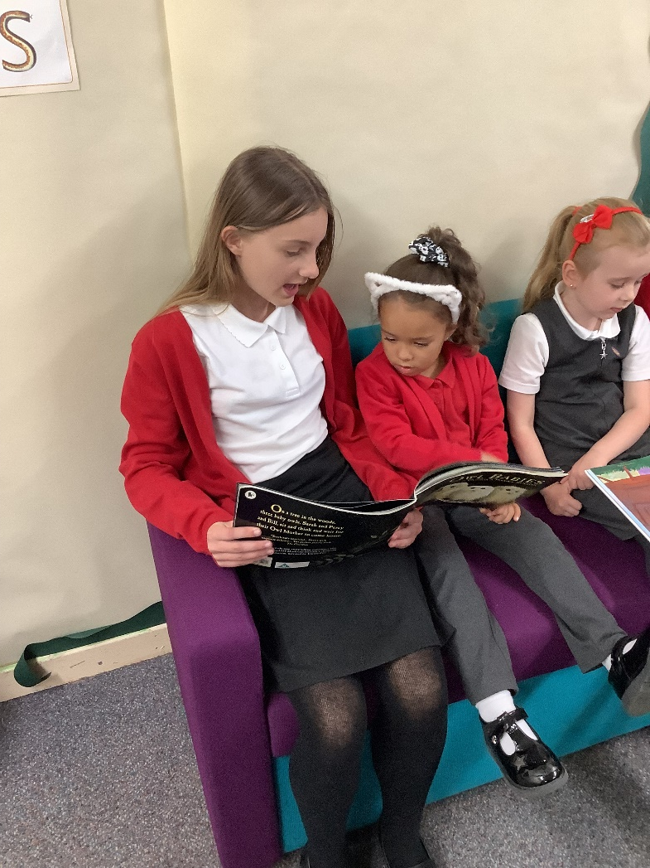
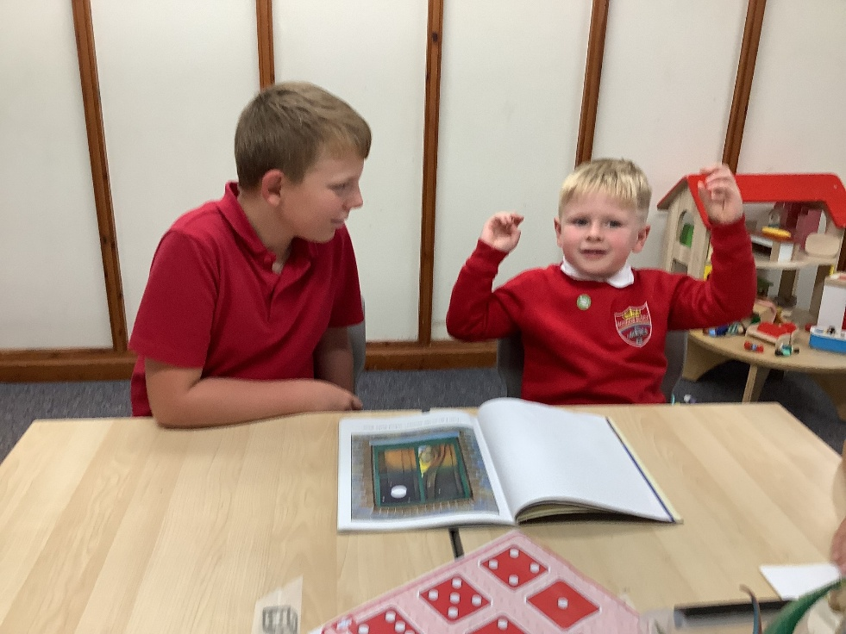
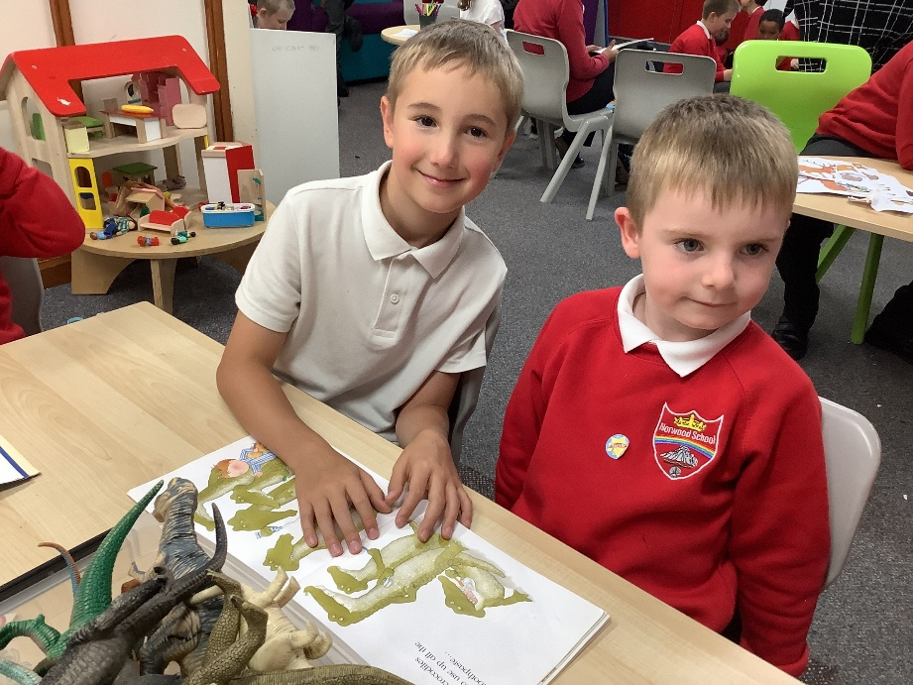
Buddies

Slide 20
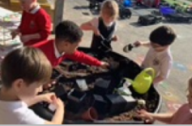
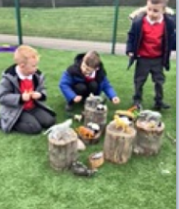
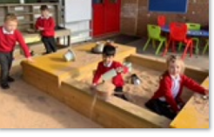
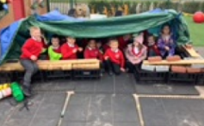
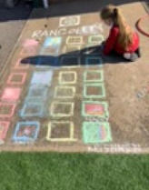
Outdoor Play

Slide 21
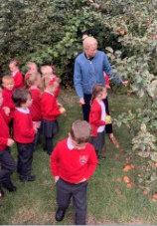
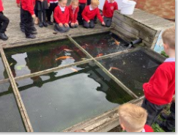
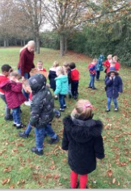
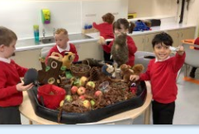

Slide 22
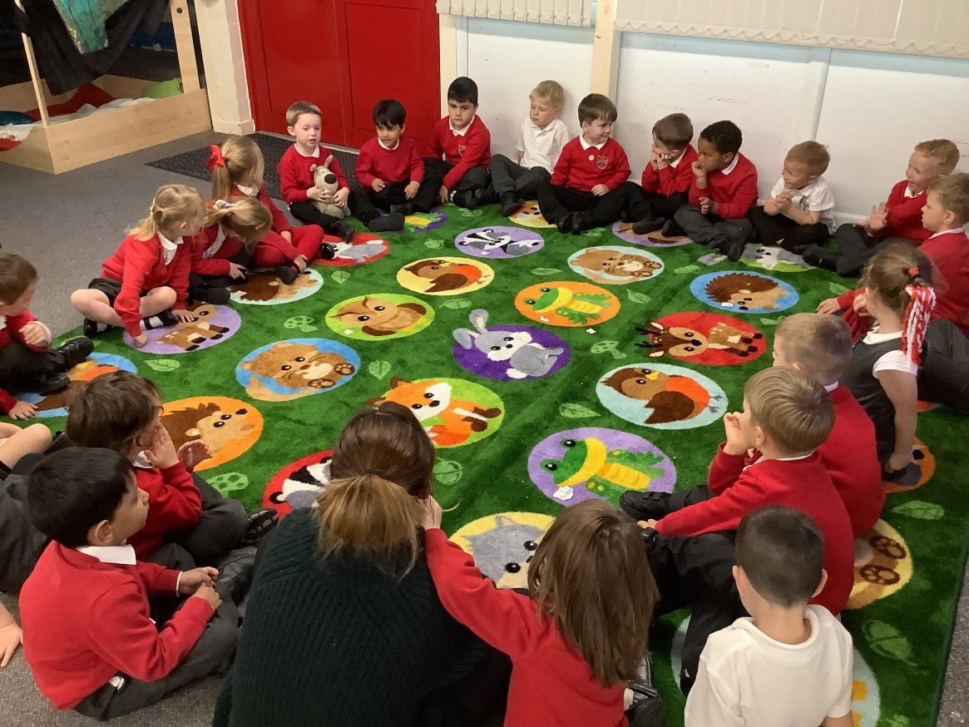
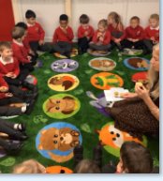
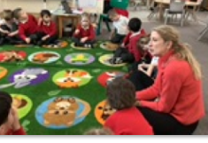
Circle times

Slide 23
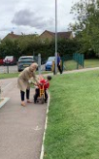
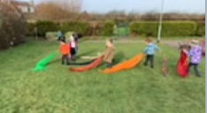
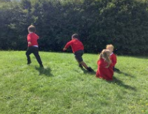
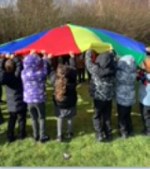
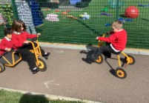
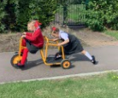


Playtimes

Slide 24






PE

Slide 25



Apparatus

Slide 26



Special days

Slide 27




Picnics
Teddy Bear Picnic
Healthy Eating
Ice Cream sunny day

Slide 28
Daytime Parent and Carer Events
Parents Evening
Autumn | Parent Carer Event Daytime in class Parents Evening Nativity Play
Spring | Parent Carer Event Daytime in class x 2 Parents Evening
Summer | Parent Carer Event x 2 Class trip Reports

Slide 29


Nativity play

Slide 30

Bailey

Slide 31


TAPESTRY You will receive a link – you will be able to see what your child is doing each week.

Slide 32

SEN – Special Educational Needs
Visits to pre-school/ nurseries
Additional adults to support as a team – not 1:1
Part-time timetables
Working together with families
Daily feedback forms, if required
SEND Web page
Family Support web page
SEND Newsletter
SENCo – Mrs Cockerill senadmin@norwoodschool.co.uk

Slide 33

EAL
Speak in own language at home
Multi lingual is an asset
Children immersed in social interaction
and language
Celebrate differences and their language

Slide 34


Slide 35


Slide 36


Slide 37


Slide 38
The importance of interactions
https://www.youtube.com/watch?v=aISXCw0Pi94

