Slide 1
National Numeracy
Schools & Families Programme
Notes:
Use this deck to introduce the Schools & Families Programme to parents and carers. You may also want to invite parents/carers to complete a Family Maths activity with their children to get an idea of how the activities work.
Explain that the school has been selected to participate in National Numeracy’s Schools & Families Programme for the next year. National Numeracy is an independent charity dedicated to helping everyone get on with numbers so they can get on with life. National Numeracy focus on empowering everyone to build their number confidence to fulfil their potential at work, home and school.

Slide 2
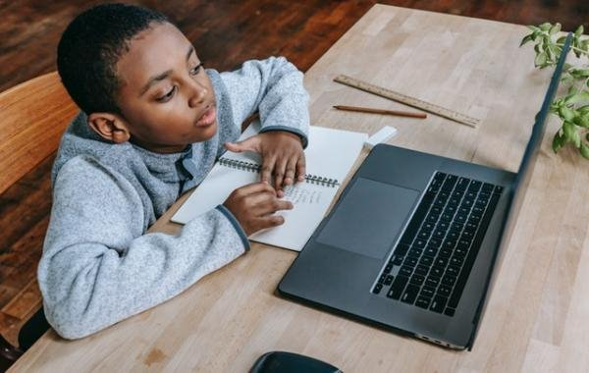
Aims of the Schools & Families Programme
To increase pupils’:
  confidence with numbers,
  positive feelings about maths,
  awareness of the value of maths outside the classroom.
To increase parents’, carers’ and school staff’s confidence in supporting children with maths.
To establish lasting approaches and strategies that will continue in schools beyond the end of the programme.
Notes:
Introduce the aims of the Schools & Families Programme.
Explain that there will be activities running through the year for staff, parents/carers and children. This is a whole school approach.

Slide 3
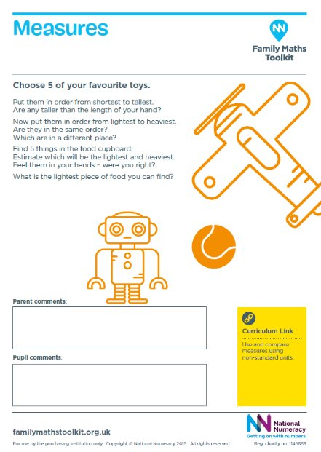
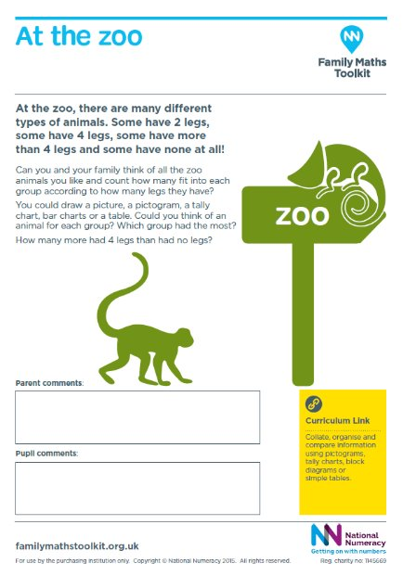
Family Maths Resources
Everyday maths activities
Encourage positive conversations at home
Complete as a family
Related to seasonal events, holidays and everyday maths
Open-ended investigations
Scrapbooks
Notes:
All years will bring home their scrapbook and an activity once a fortnight. WRM will be the alternate fortnight and will continue to be linked to learning in school.
The Family Maths activities will help children and families to explore everyday maths together. They link the maths that children are learning at school with life outside.
You don’t need any special knowledge or equipment to work on the activities. Just talking about everyday maths can help develop children’s maths confidence.
You might like to take photos, draw pictures, write sums, or create diagrams in the scrapbooks it’s up to you.
Family maths activites are on the tables to look at
Explain the space for family and child comments.
scrapbooks should be brought to school by the end of the following week so that ?
if they would like some help just email school or contact your teacher

Slide 4
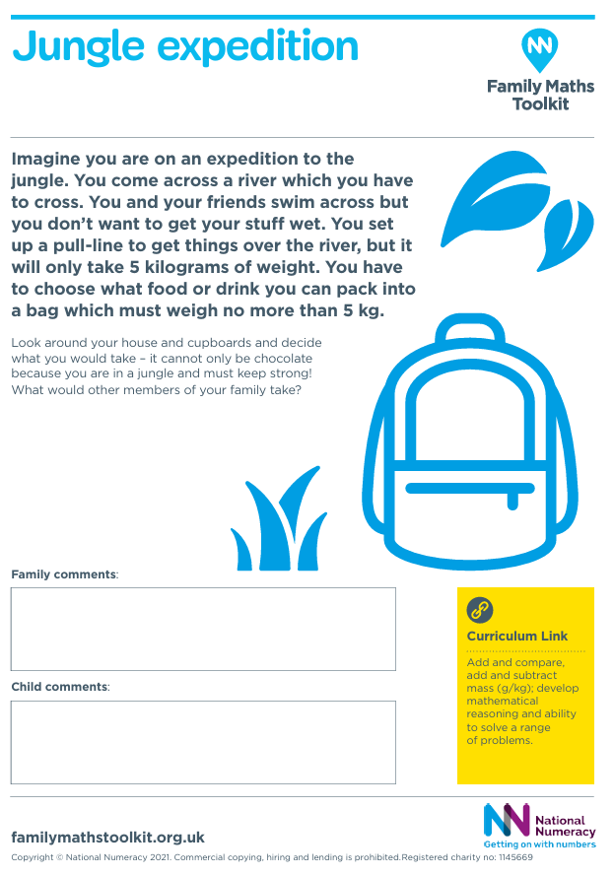
Family Maths – Year 3 example

Slide 5
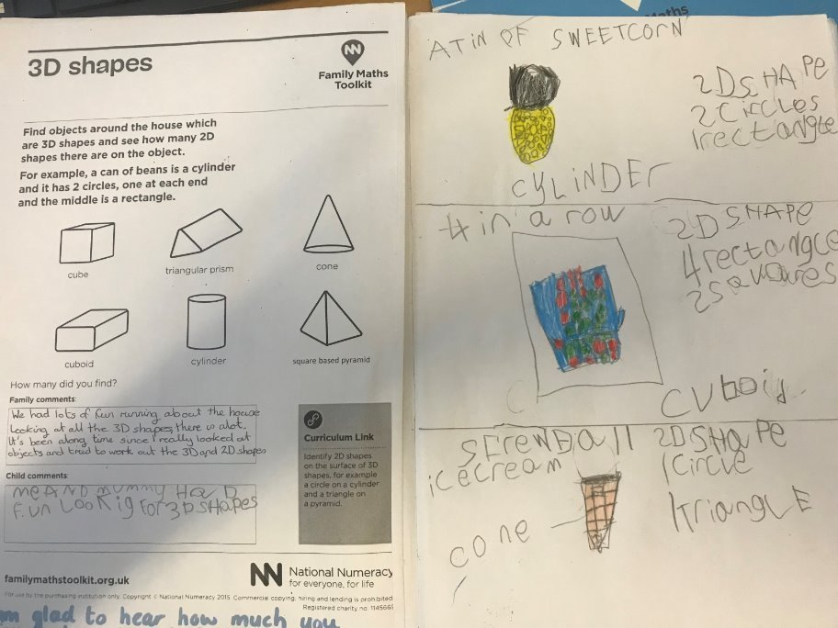
Family Maths Resources
Notes:
Share these completed examples with parents and carers

Slide 6
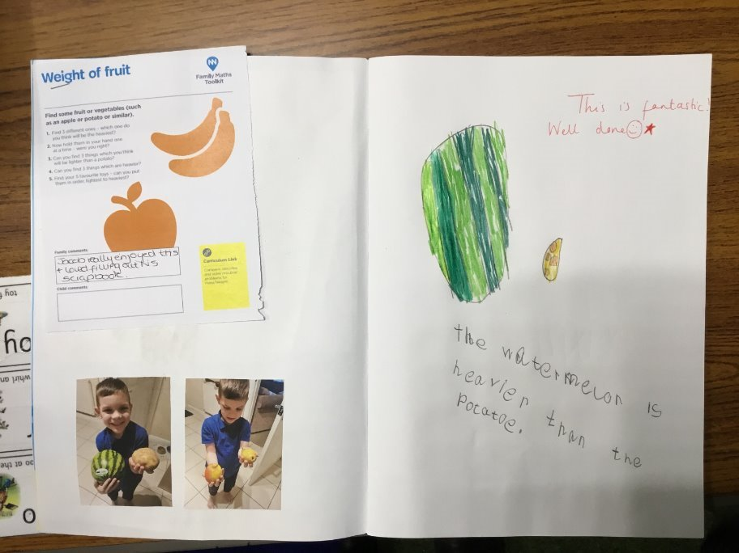
Family Maths Resources
Notes:
Share these completed examples with parents and carers

Slide 7
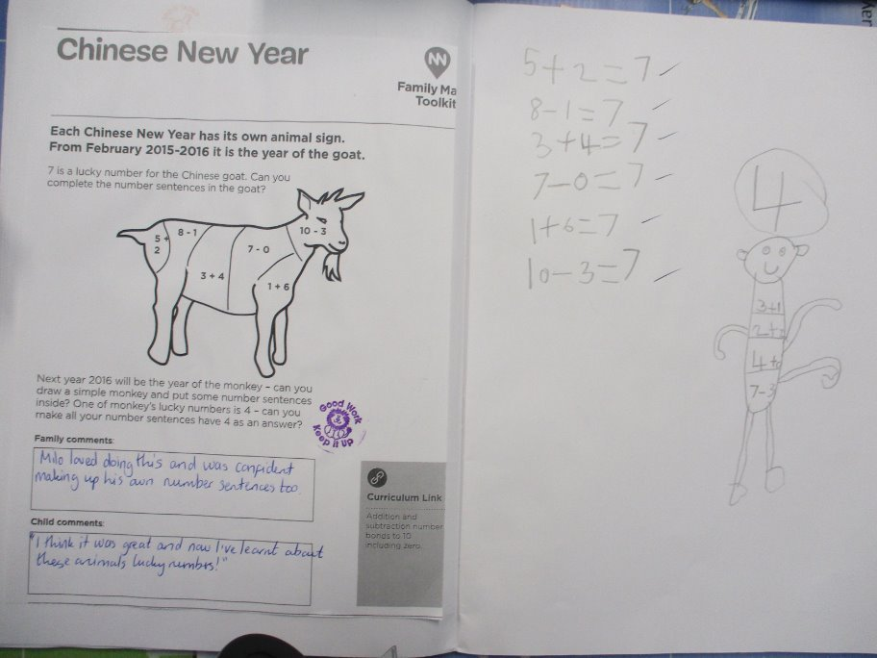
Family Maths Resources
Notes:
Share these completed examples with parents and carers

Slide 8
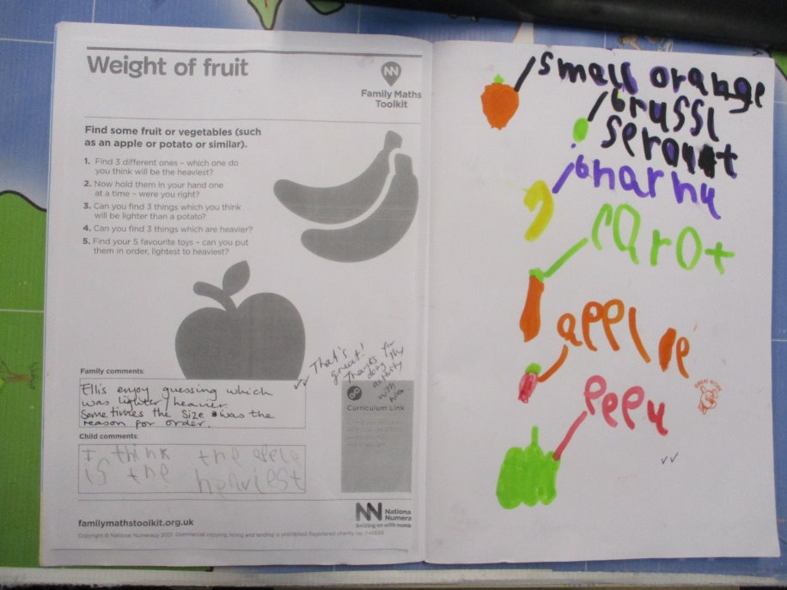
Family Maths Resources
Notes:
Share these completed examples with parents and carers

Slide 9
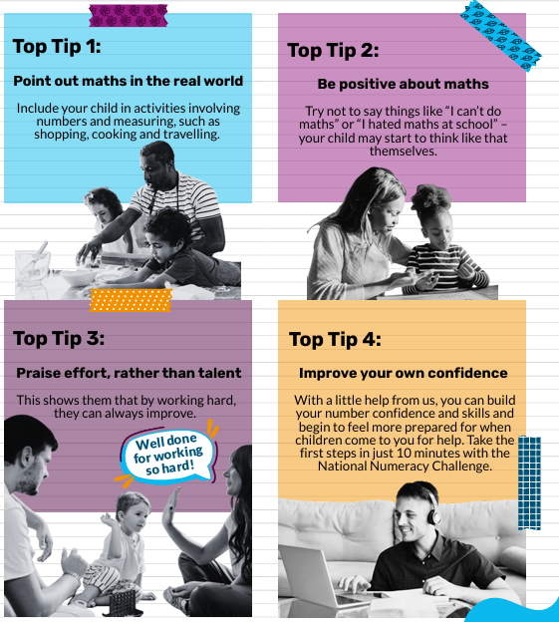
Notes:
We all want children to feel confident with numbers, even if we struggle with maths ourselves! Everyone can help children with maths – you don’t need to be an expert. How you can help with maths at home:

Slide 10
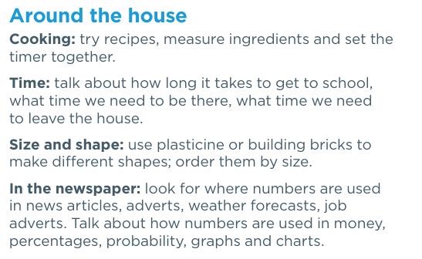
Pointing out maths in the real world
For younger children There are lots of places to find maths in day-to-day life. Here are a few you could try.
Notes:
We all use numbers every day, whether we think about it or not. Maths is not just for the classroom. Spotting maths in the real world helps children understand this. It helps them see why it’s useful to learn maths. And it’s something you can do to support your child’s maths learning outside of school. There are all sorts of ways to bring number skills into things you already do with your child. For younger children There are lots of places to find maths in day-to-day life. Here are a few you could try.

Slide 11
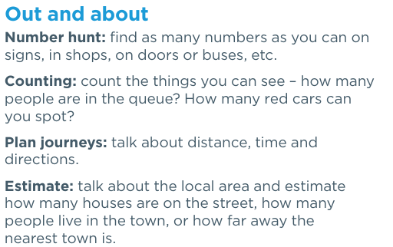
Pointing out maths in the real world
For younger children There are lots of places to find maths in day-to-day life. Here are a few you could try.
Notes:
We all use numbers every day, whether we think about it or not. Maths is not just for the classroom. Spotting maths in the real world helps children understand this. It helps them see why it’s useful to learn maths. And it’s something you can do to support your child’s maths learning outside of school. There are all sorts of ways to bring number skills into things you already do with your child. For younger children There are lots of places to find maths in day-to-day life. Here are a few you could try.

Slide 12
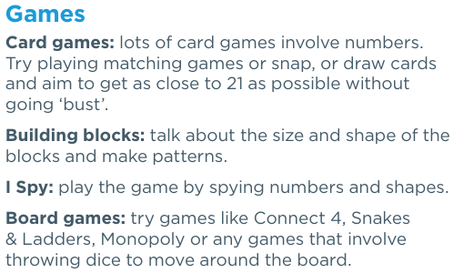
Pointing out maths in the real world
For younger children There are lots of places to find maths in day-to-day life. Here are a few you could try.
Notes:
We all use numbers every day, whether we think about it or not. Maths is not just for the classroom. Spotting maths in the real world helps children understand this. It helps them see why it’s useful to learn maths. And it’s something you can do to support your child’s maths learning outside of school. There are all sorts of ways to bring number skills into things you already do with your child. For younger children There are lots of places to find maths in day-to-day life. Here are a few you could try.

Slide 13
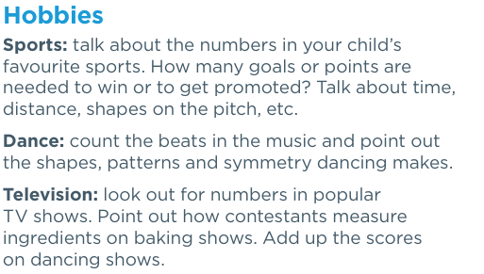
Pointing out maths in the real world
For younger children There are lots of places to find maths in day-to-day life. Here are a few you could try.
Notes:
We all use numbers every day, whether we think about it or not. Maths is not just for the classroom. Spotting maths in the real world helps children understand this. It helps them see why it’s useful to learn maths. And it’s something you can do to support your child’s maths learning outside of school. There are all sorts of ways to bring number skills into things you already do with your child. For younger children There are lots of places to find maths in day-to-day life. Here are a few you could try.

Slide 14
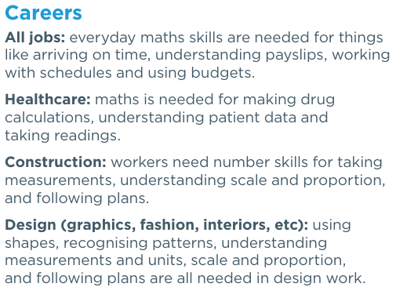
Pointing out maths in the real world
For older children Beyond school, adults use maths in lots of ways. Talking about this can help older children see the value of learning maths. Here are a few examples.
Where do you use maths in your work or daily life? What does your child want to do after they leave school? What number skills will they need for that?
Notes:
We all use numbers every day, whether we think about it or not. Maths is not just for the classroom. Spotting maths in the real world helps children understand this. It helps them see why it’s useful to learn maths. And it’s something you can do to support your child’s maths learning outside of school. There are all sorts of ways to bring number skills into things you already do with your child. For younger children There are lots of places to find maths in day-to-day life. Here are a few you could try.

Slide 15
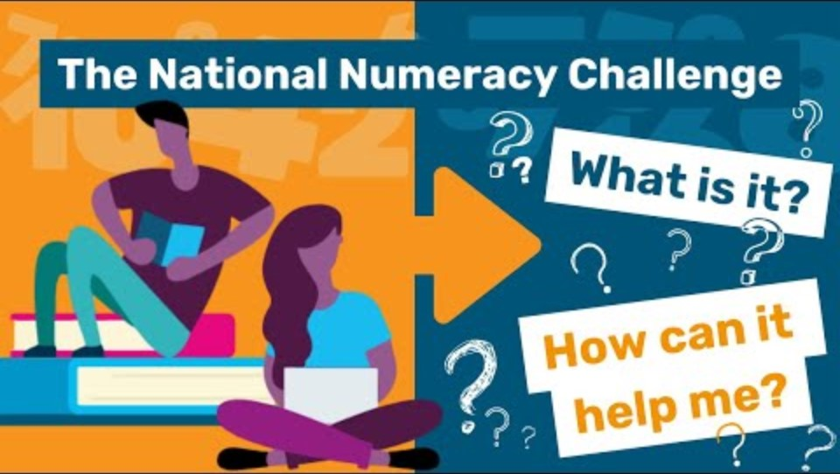
National Numeracy Challenge
Notes:
However you feel about maths yourself, you can still help your child be positive about maths. Whatever your number skills are like, you can still support your child’s maths learning. But some people feel more comfortable about doing that by working on their own number confidence too. And this doesn’t have to mean going back to the classroom! The National Numeracy Challenge is an online learning tool for adults who have low confidence in their maths skills: www.nnchallenge.org.uk/fmt You can register for free: all you need is an email address and a password. When you have signed up, you can take a quick check of your skills. This usually takes around 10 minutes.
The quick check isn’t a test – it’s just to help the Challenge find the best resources and support for you. In the quick check: • The questions focus on everyday maths – the skills you use in real life • There are no time limits on any questions or the quick check as a whole • Everything is kept confidential, so you don’t have the pressure of other people knowing how you answer • You only get asked enough questions to find the support you need – if you’re finding it difficult, the questions won’t get harder • You can save your progress as you go, so you don’t have to complete it all in one go.
When you have used some resources and feel ready, you can have another go at the quick check. This will give you more resources and help you see if you’ve improved. Remember – you don’t have to be a maths genius to help your children with maths! But becoming more confident with numbers can only be a good thing. Even if you find things difficult, you are showing your child that everyone can learn and get better at maths – and finding things hard is a normal part of the learning process, for both adults and children.

Slide 16
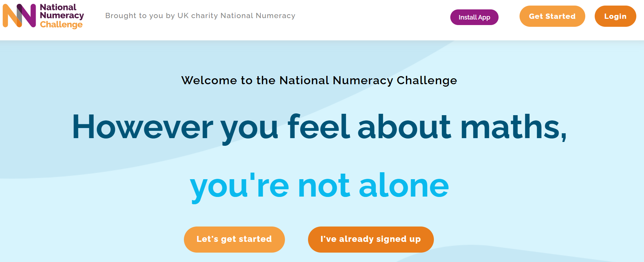
Notes:
Go to website and create a fake account

Slide 17

Help Your Child Love Maths Parent/Carer Workshop
19th October 2026
Notes:
the purpose of the session is to support adults to develop positive attitudes in the children they support.
It will explore each of National Numeracy’s top tips for supporting children.
It is aimed at adults supporting children, including parents, carers, grandparents, school staff, etc.
there will be no actual maths involved – no tests or quick fire times tables or worksheets!
the session will be interactive and supportive

